Slide 1
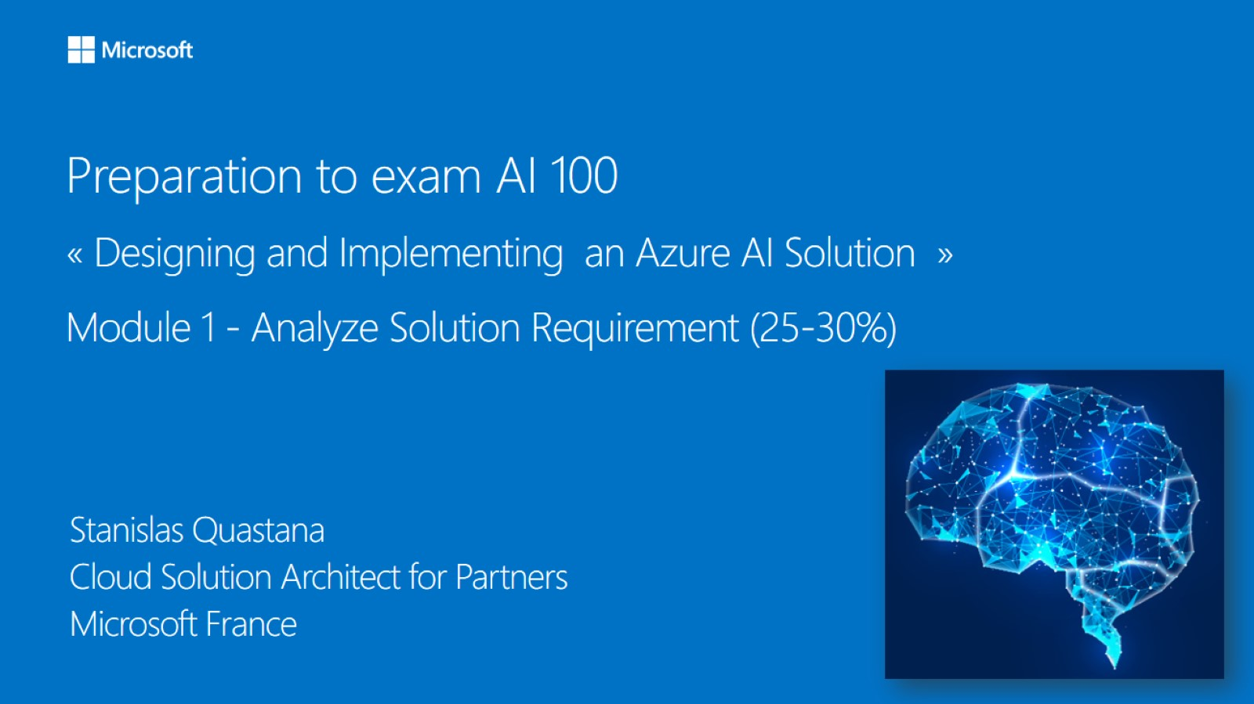

Meet Bhagdev
Program Manager
Microsoft

Slide 2
Agenda - Prepare for the Microsoft AI 100 certification exam
December 9th – December 12th
Theory
Lots of hands on labs
Practice questions

Slide 3
What is the Microsoft AI 100 exam?
AI-100 Certification is for engineers who have intermediate to an expert level understanding of Machine Learning and are responsible for deploying end-to-end AI solutions on Azure using various AI & ML services.

Slide 4
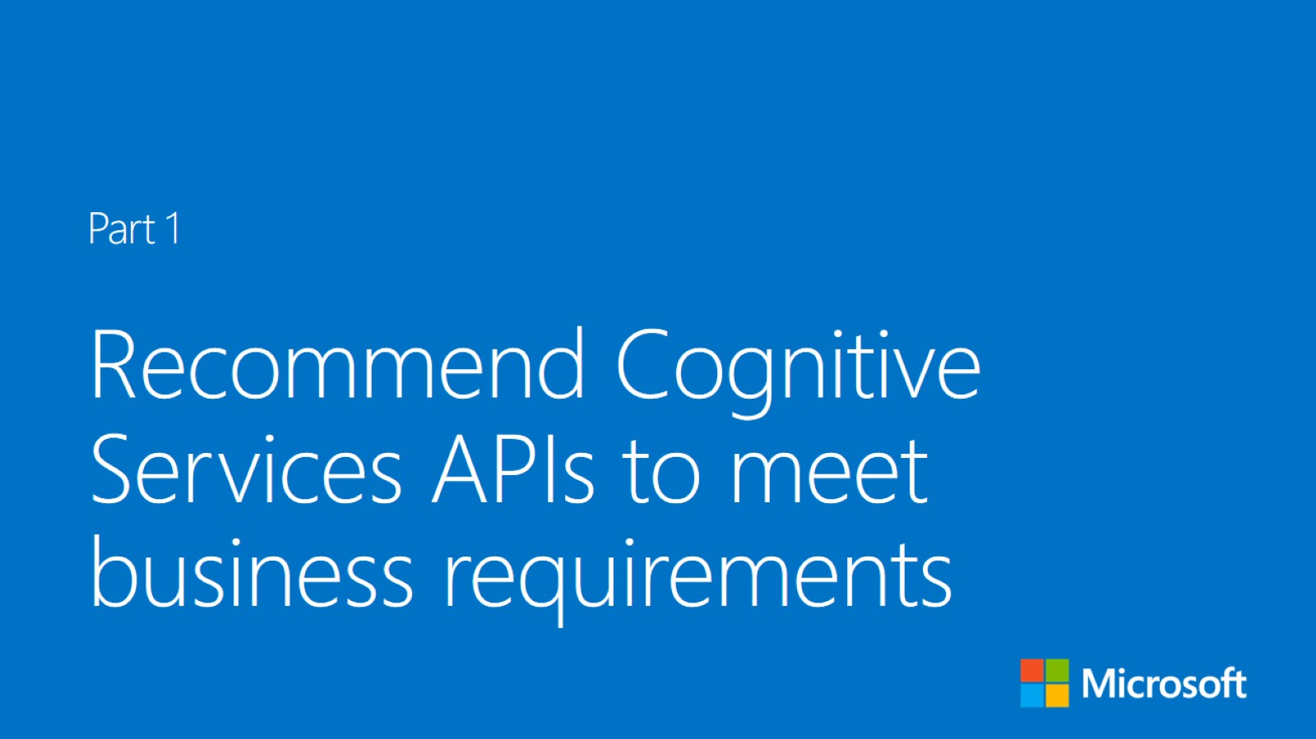

Slide 5
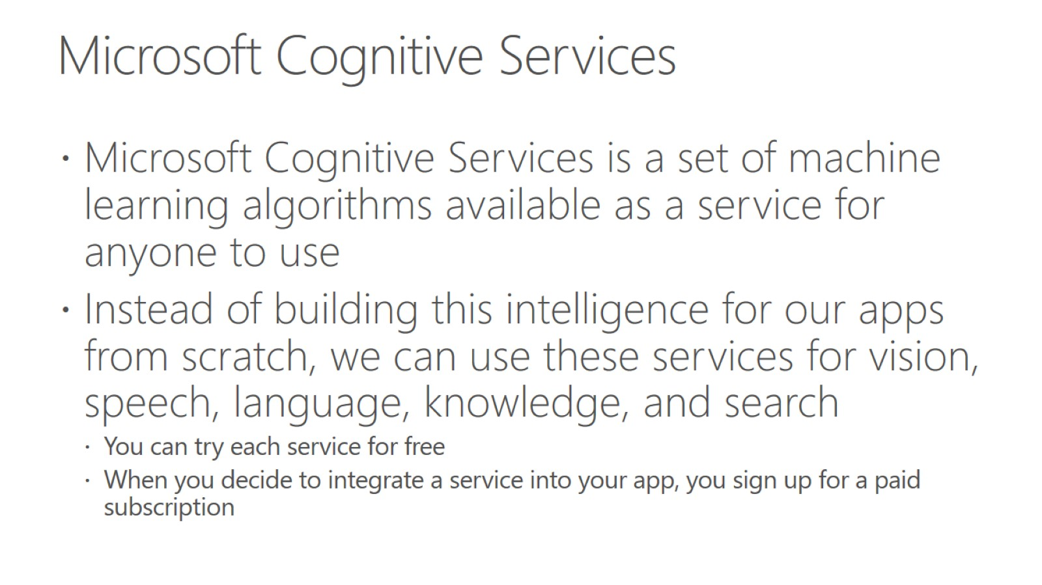
Microsoft Cognitive Services

Slide 6
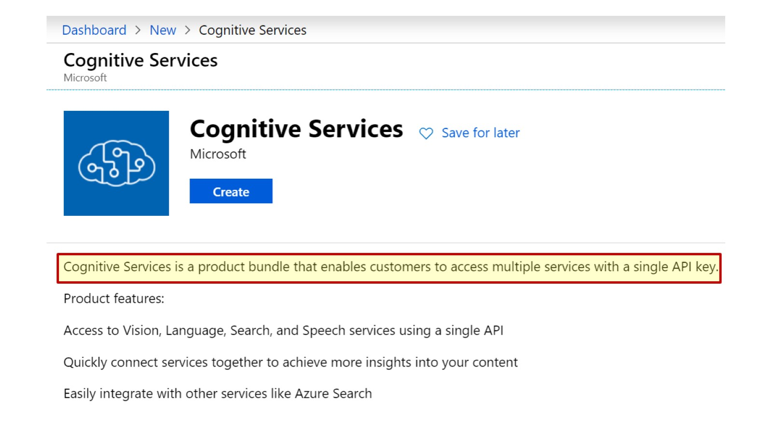

Slide 7
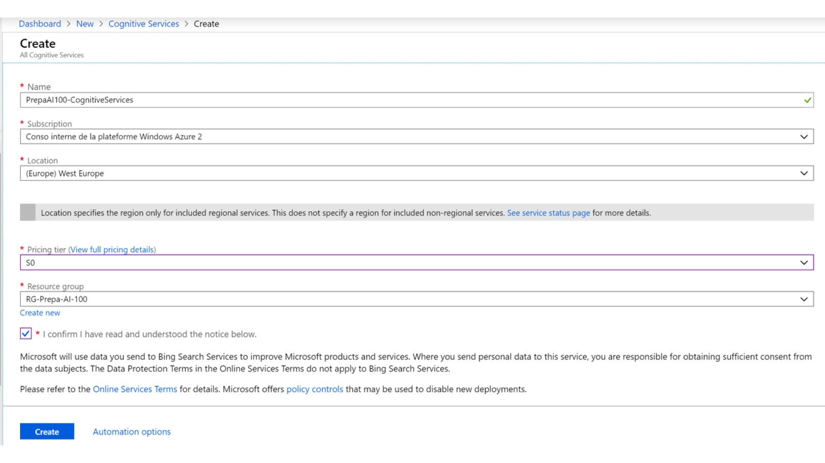

Slide 8
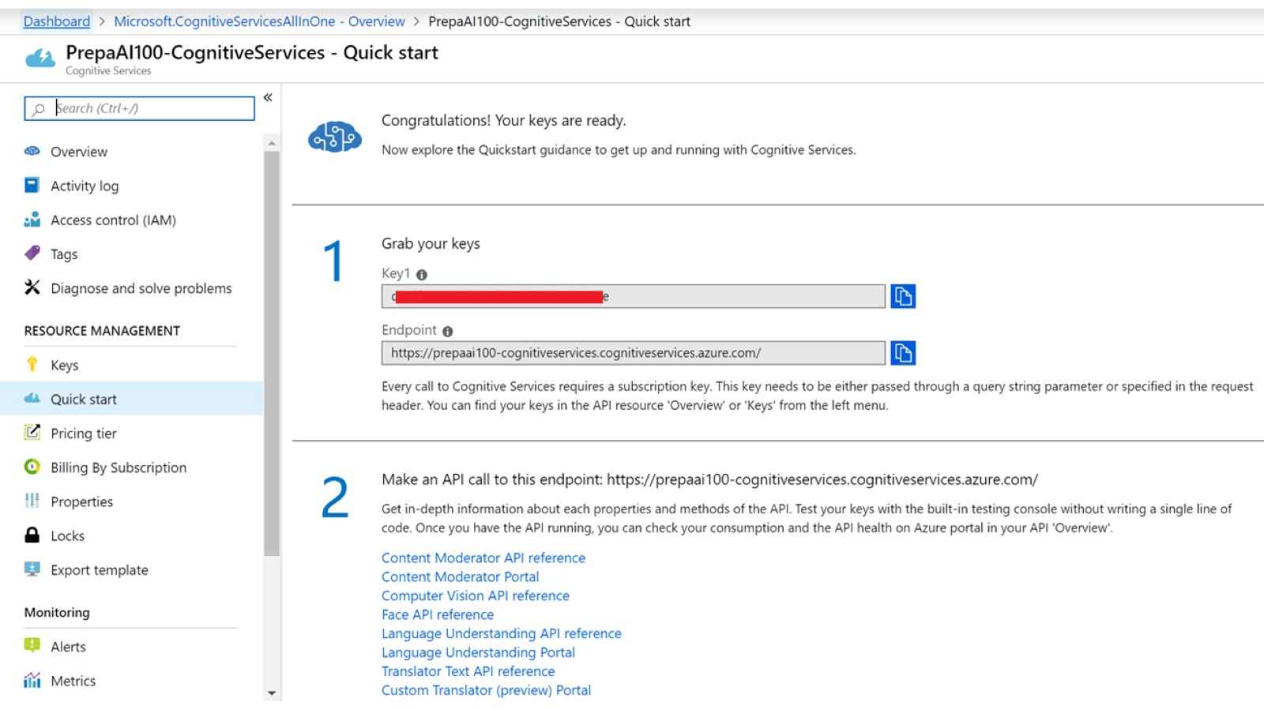

Slide 9
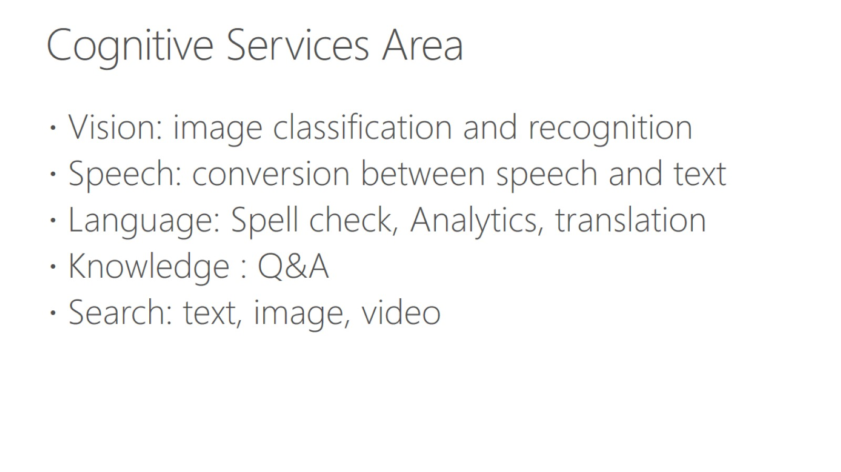
Cognitive Services Area

Slide 10
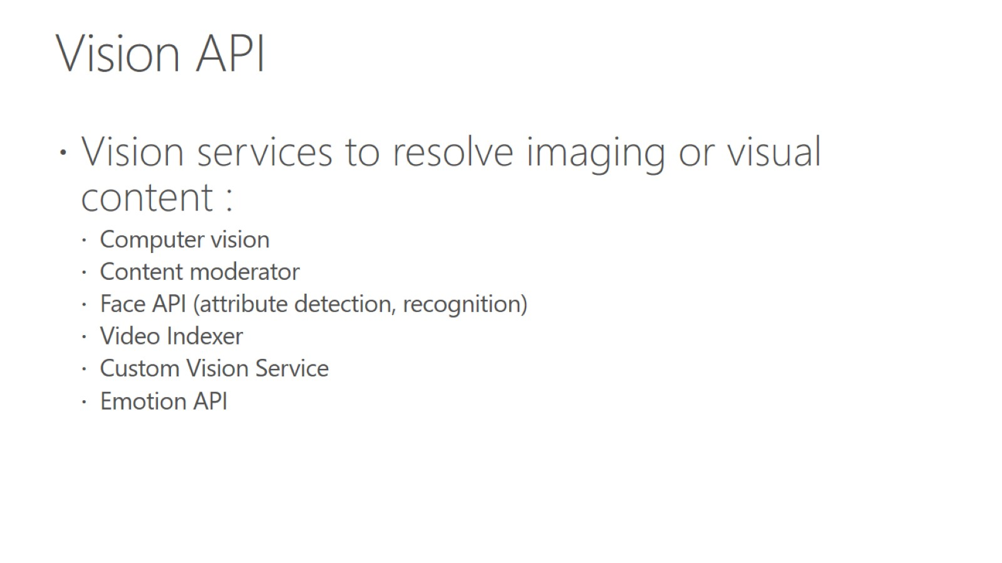
Vision API

Slide 11
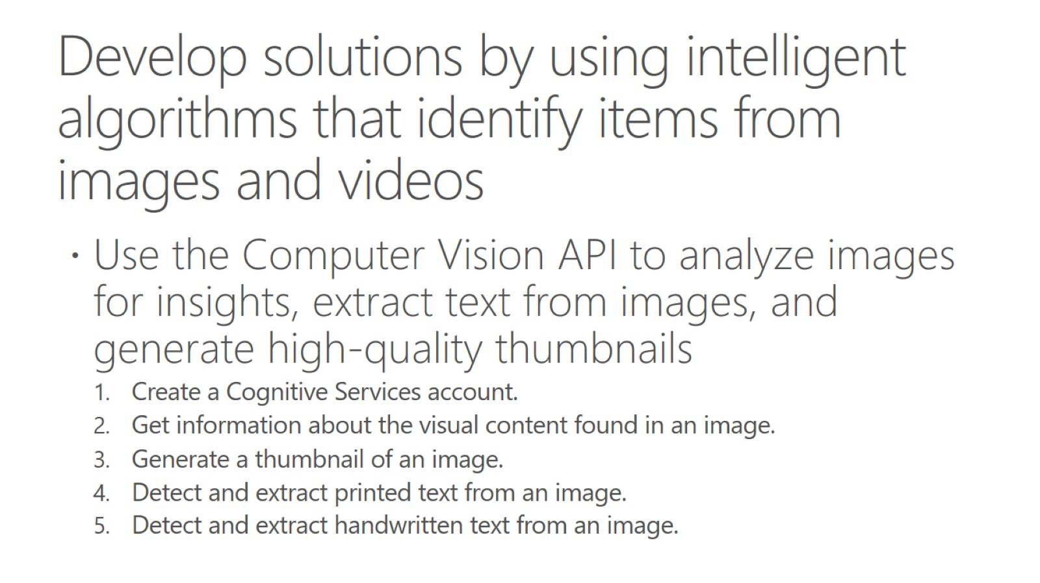
Develop solutions by using intelligent algorithms that identify items from images and videos

Slide 12
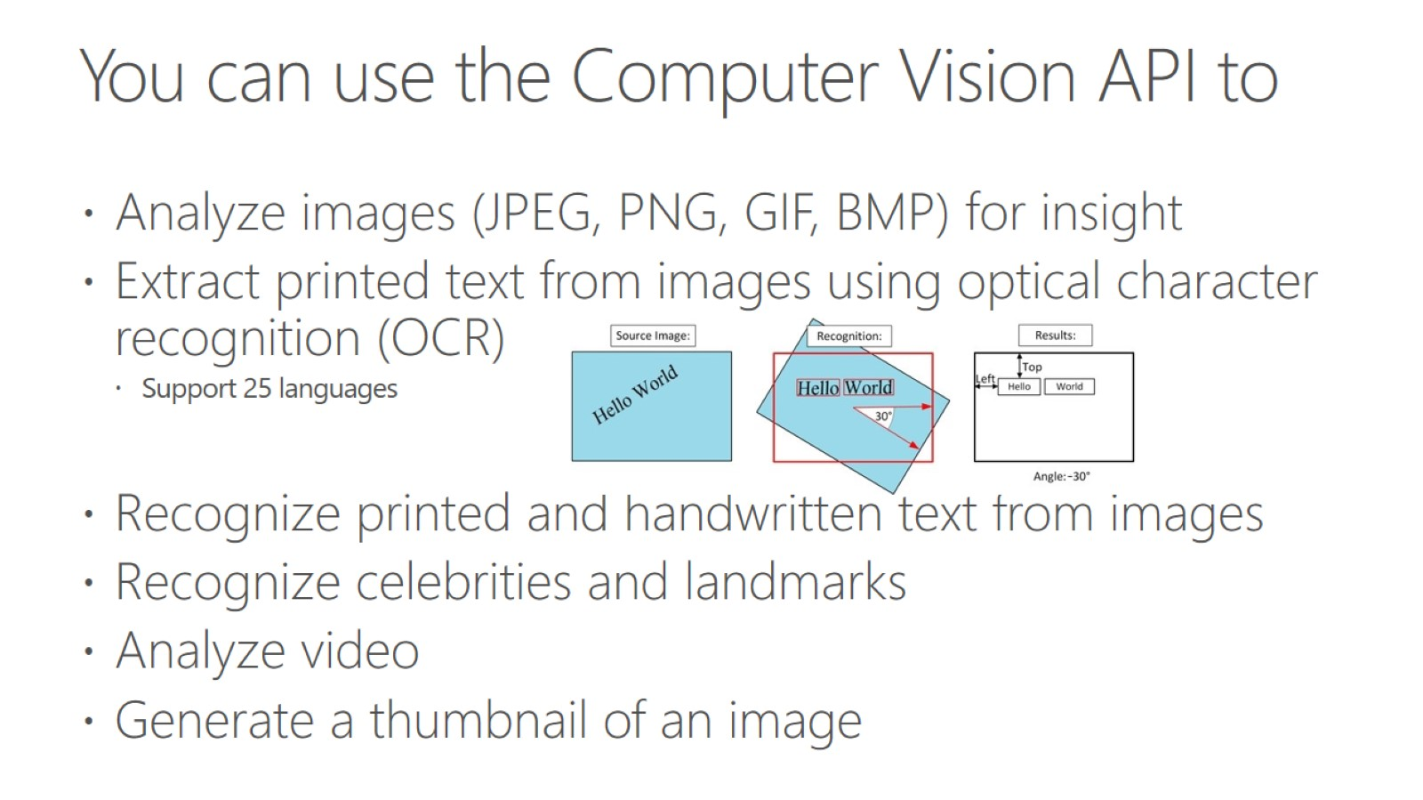
You can use the Computer Vision API to

Slide 13
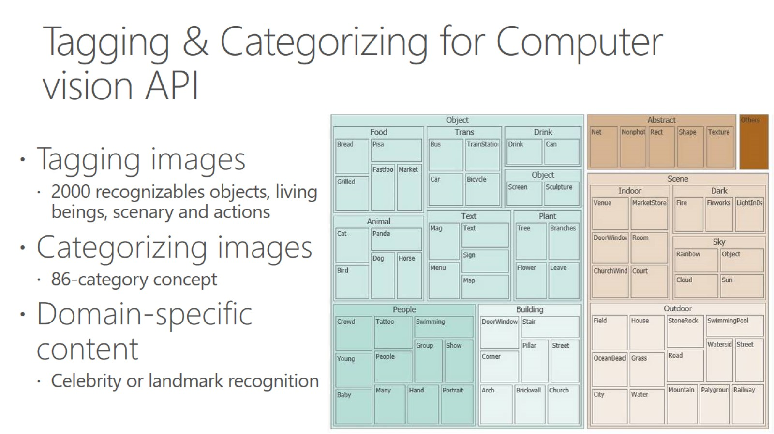
Tagging & Categorizing for Computer vision API

Slide 14
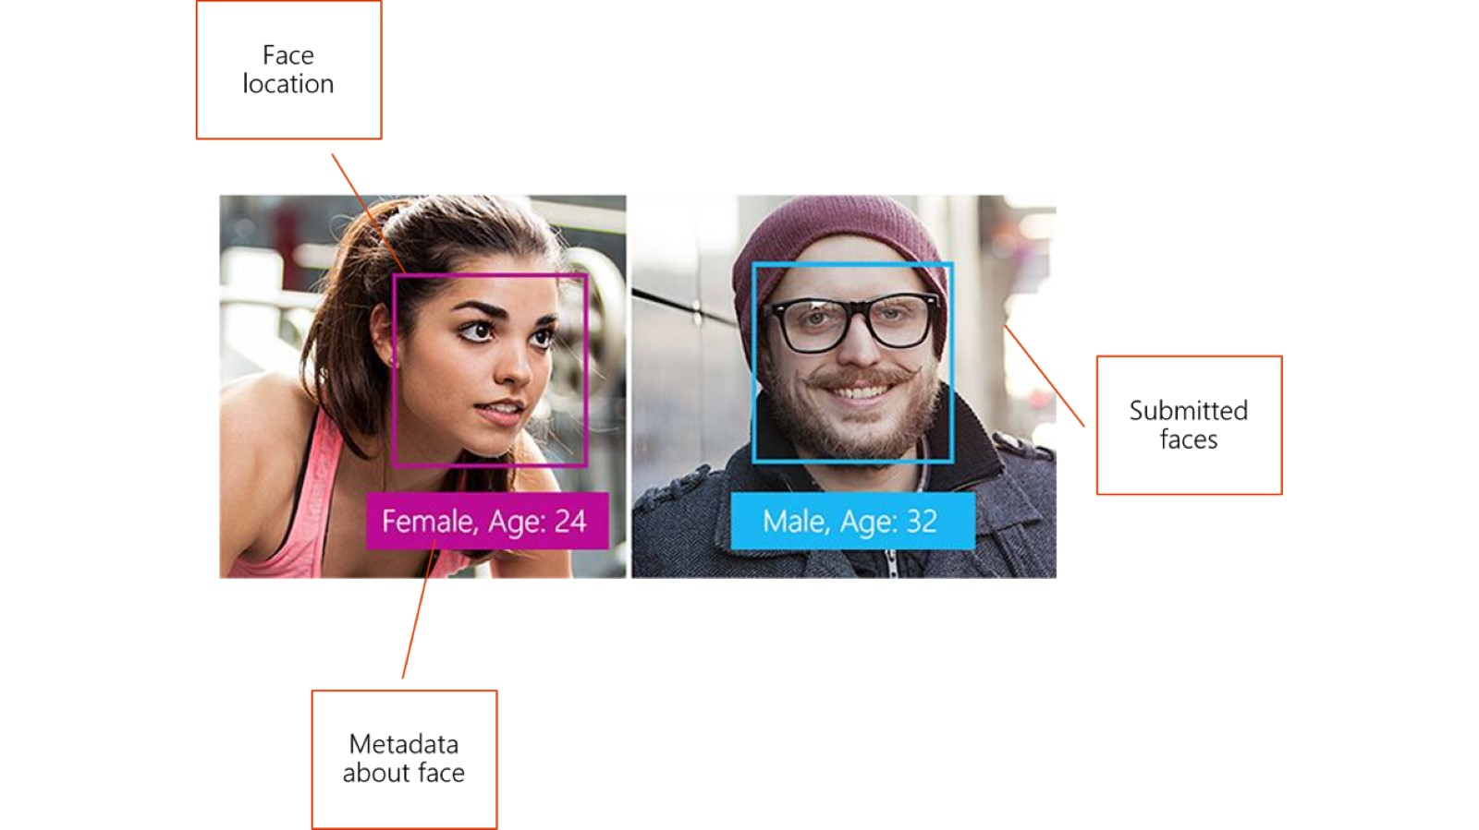

Slide 15
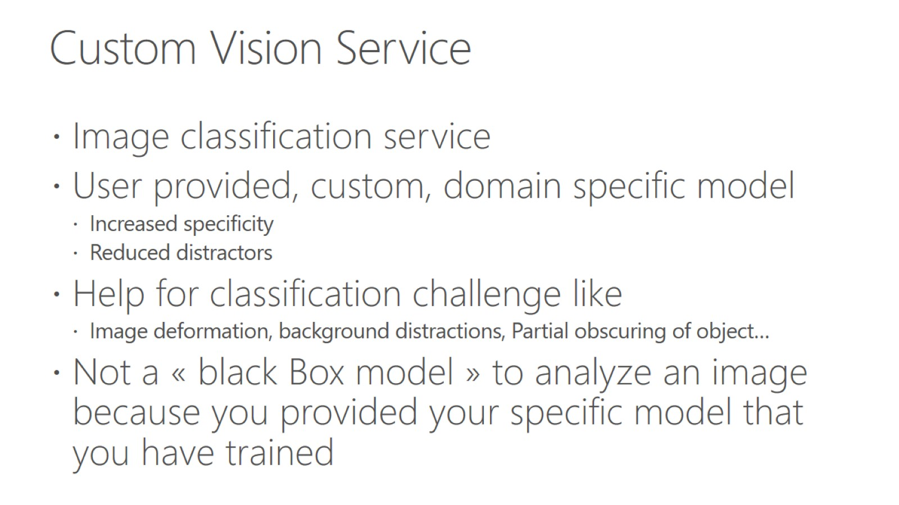
Custom Vision Service

Slide 16
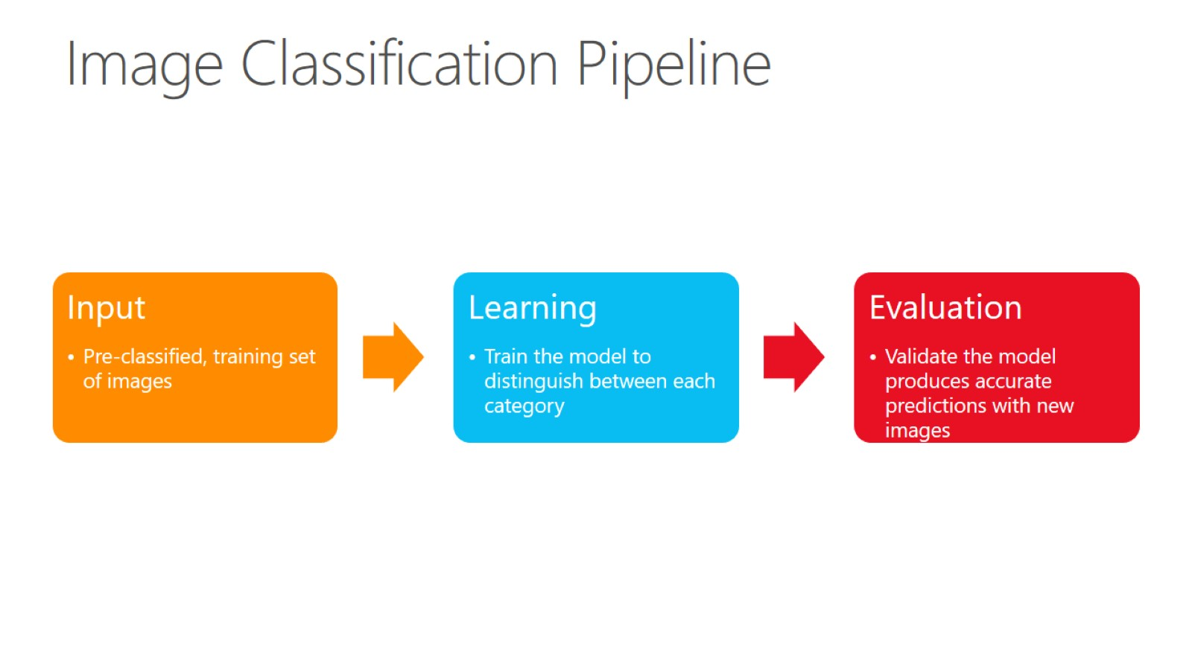
Image Classification Pipeline

Slide 17
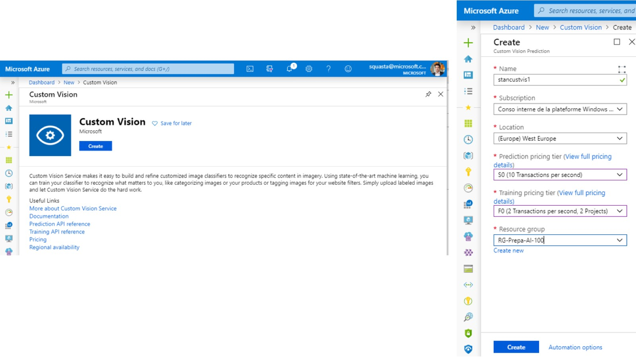

Slide 18
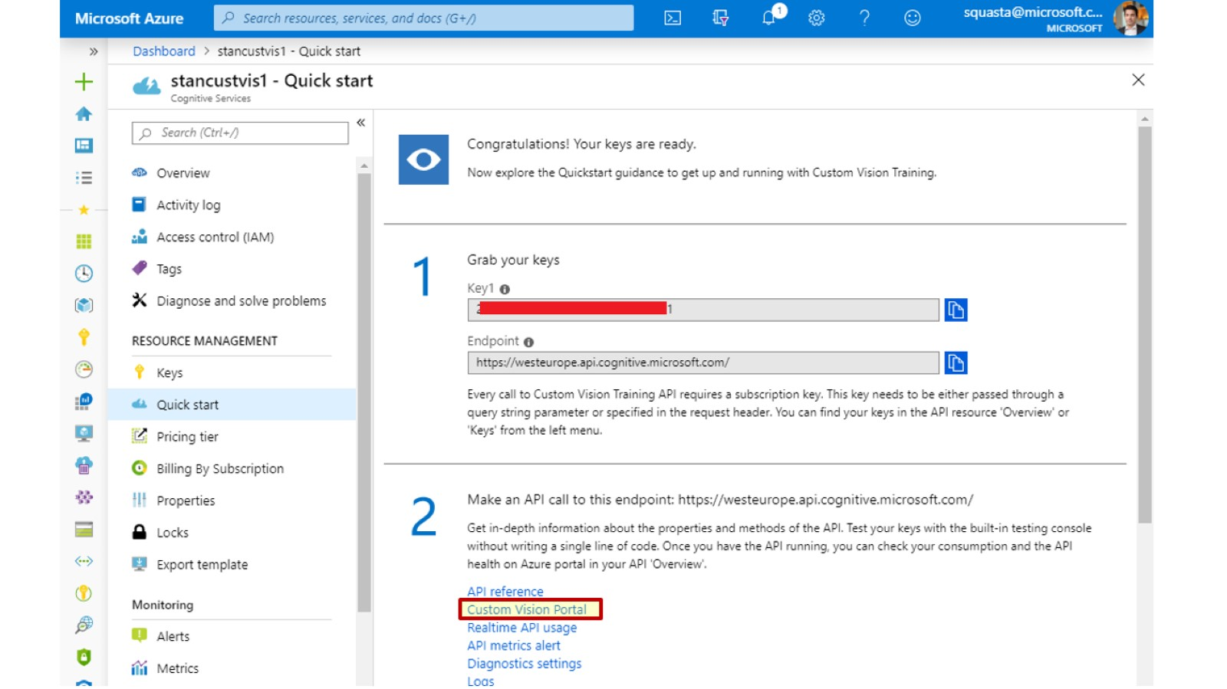

Slide 19
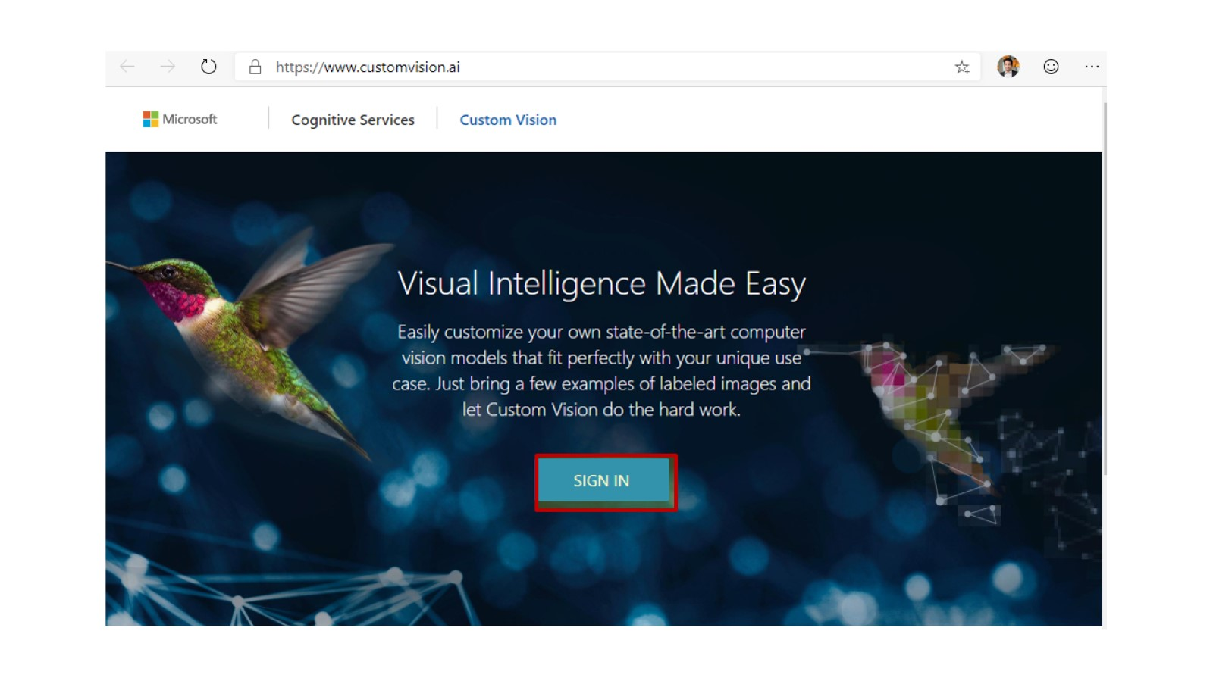

Slide 20
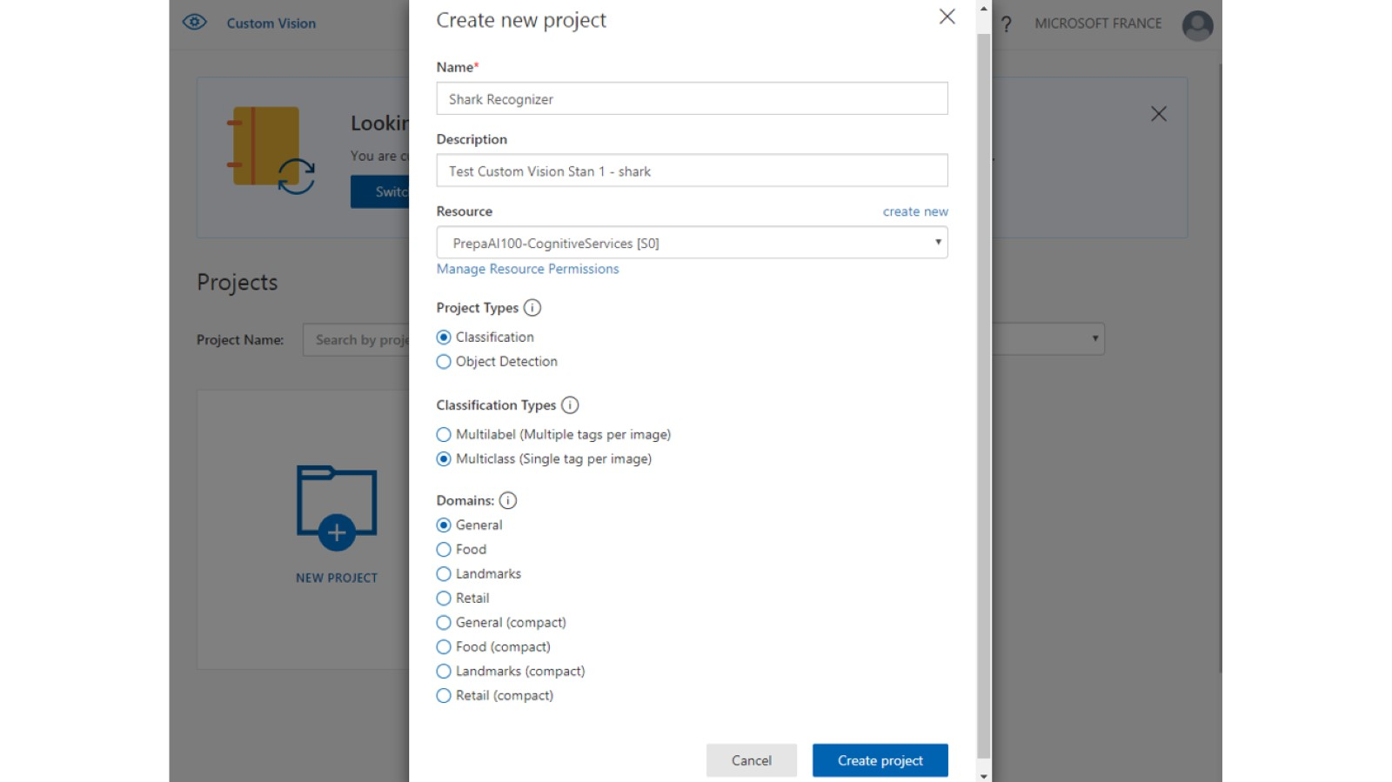

Slide 21
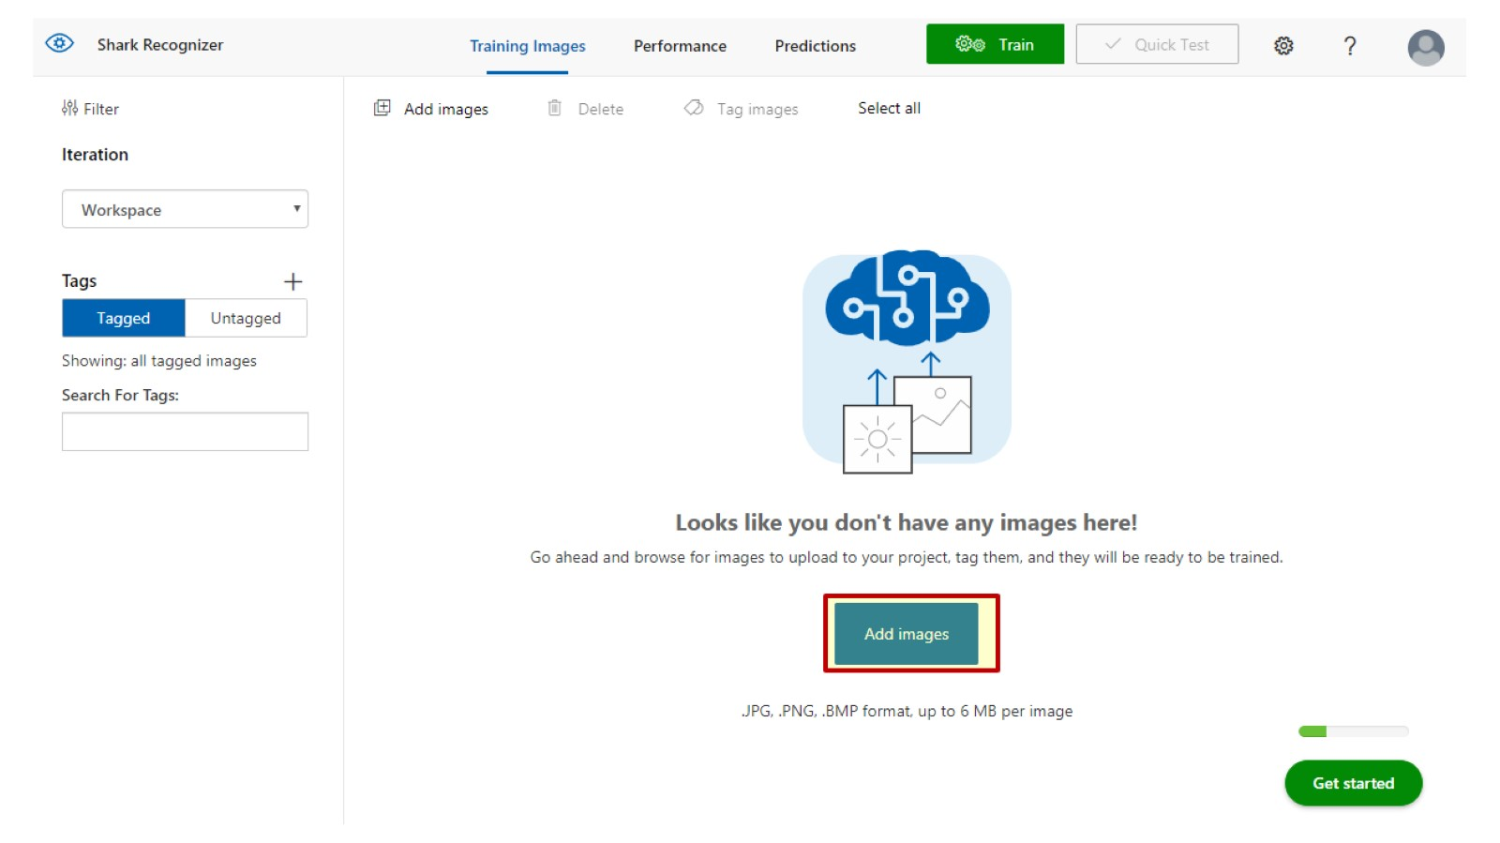

Slide 22
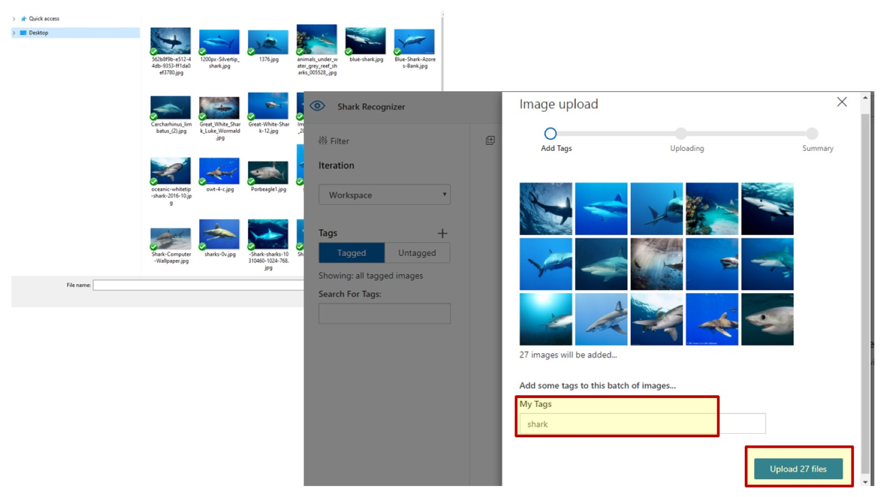

Slide 23
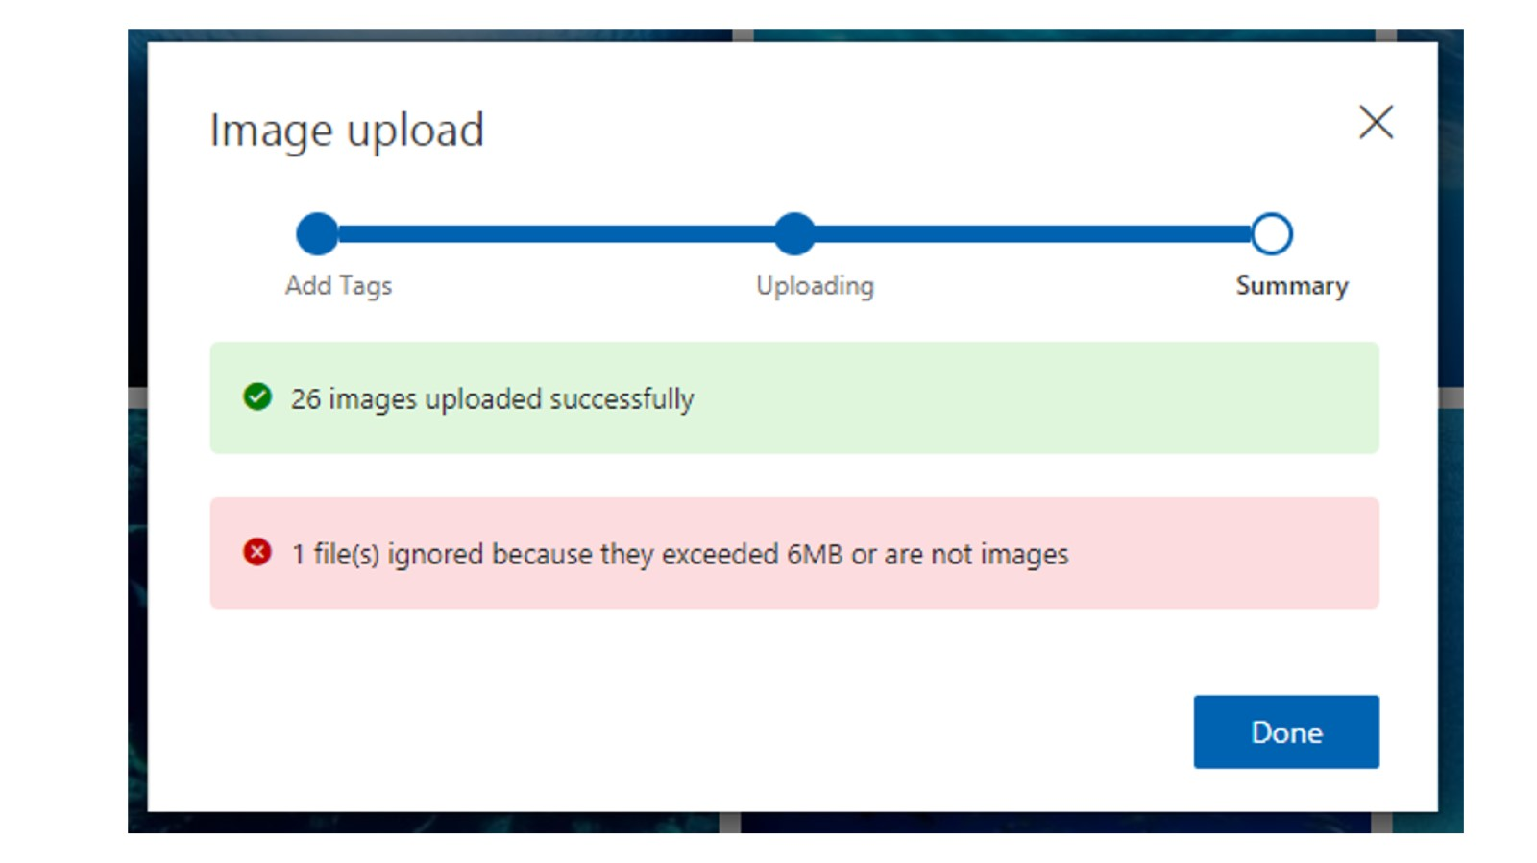

Slide 24
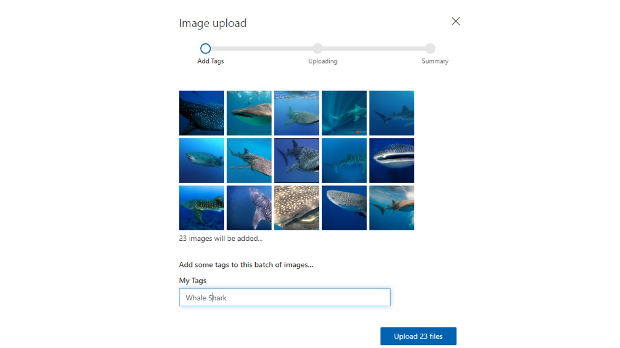

Slide 25
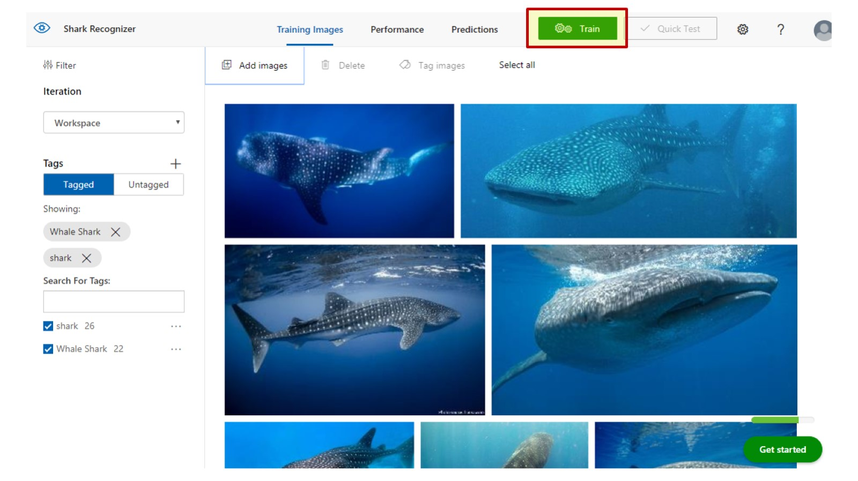

Slide 26
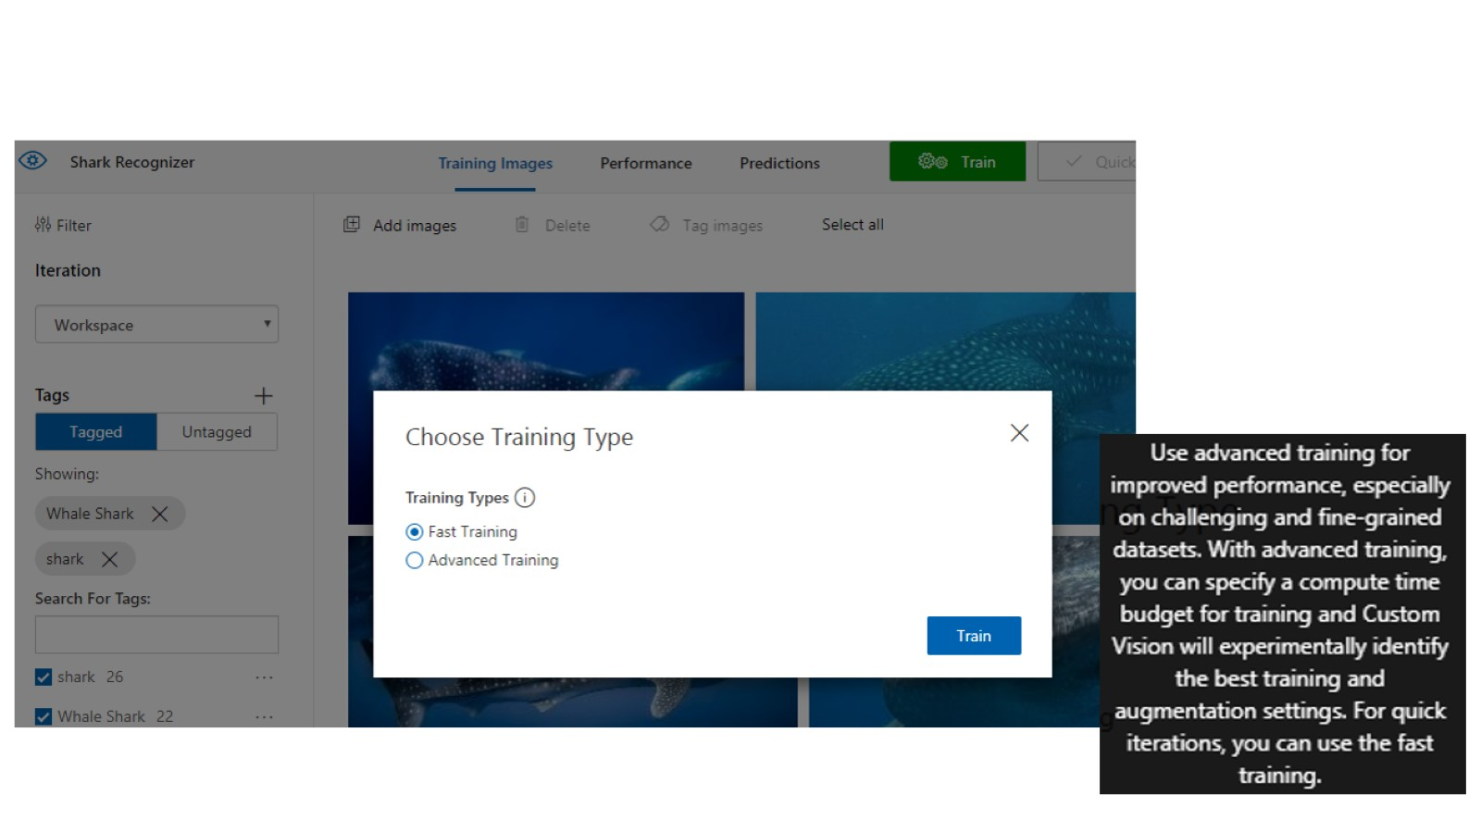

Slide 27
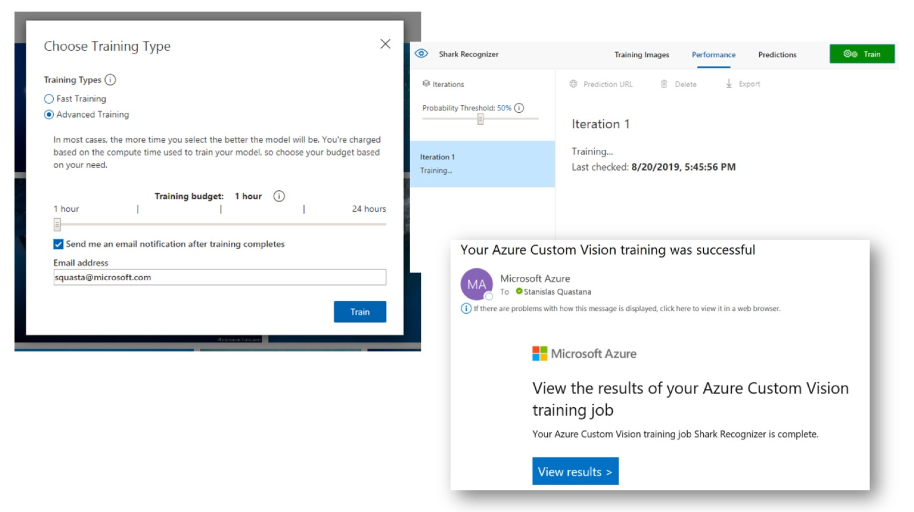

Slide 28
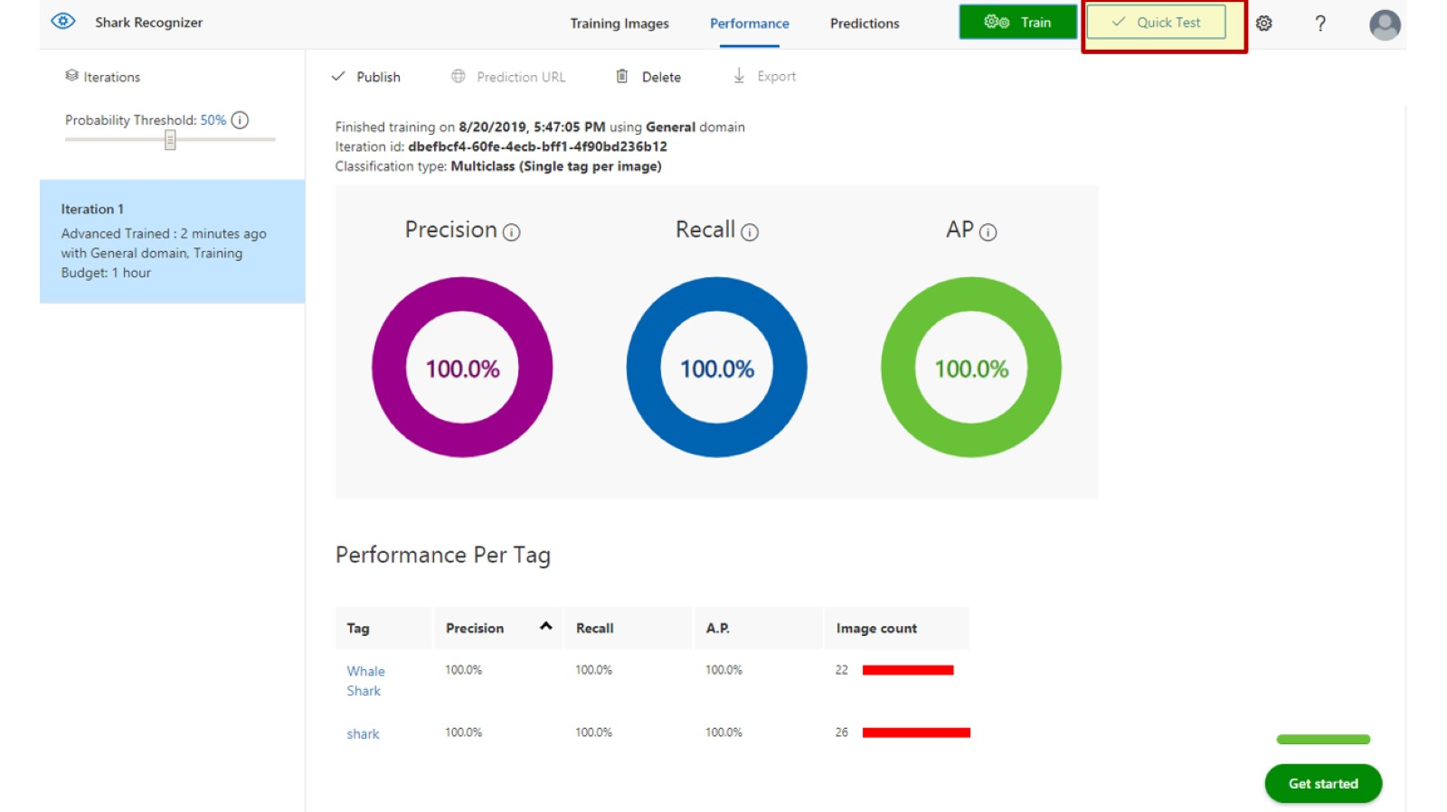

Slide 29
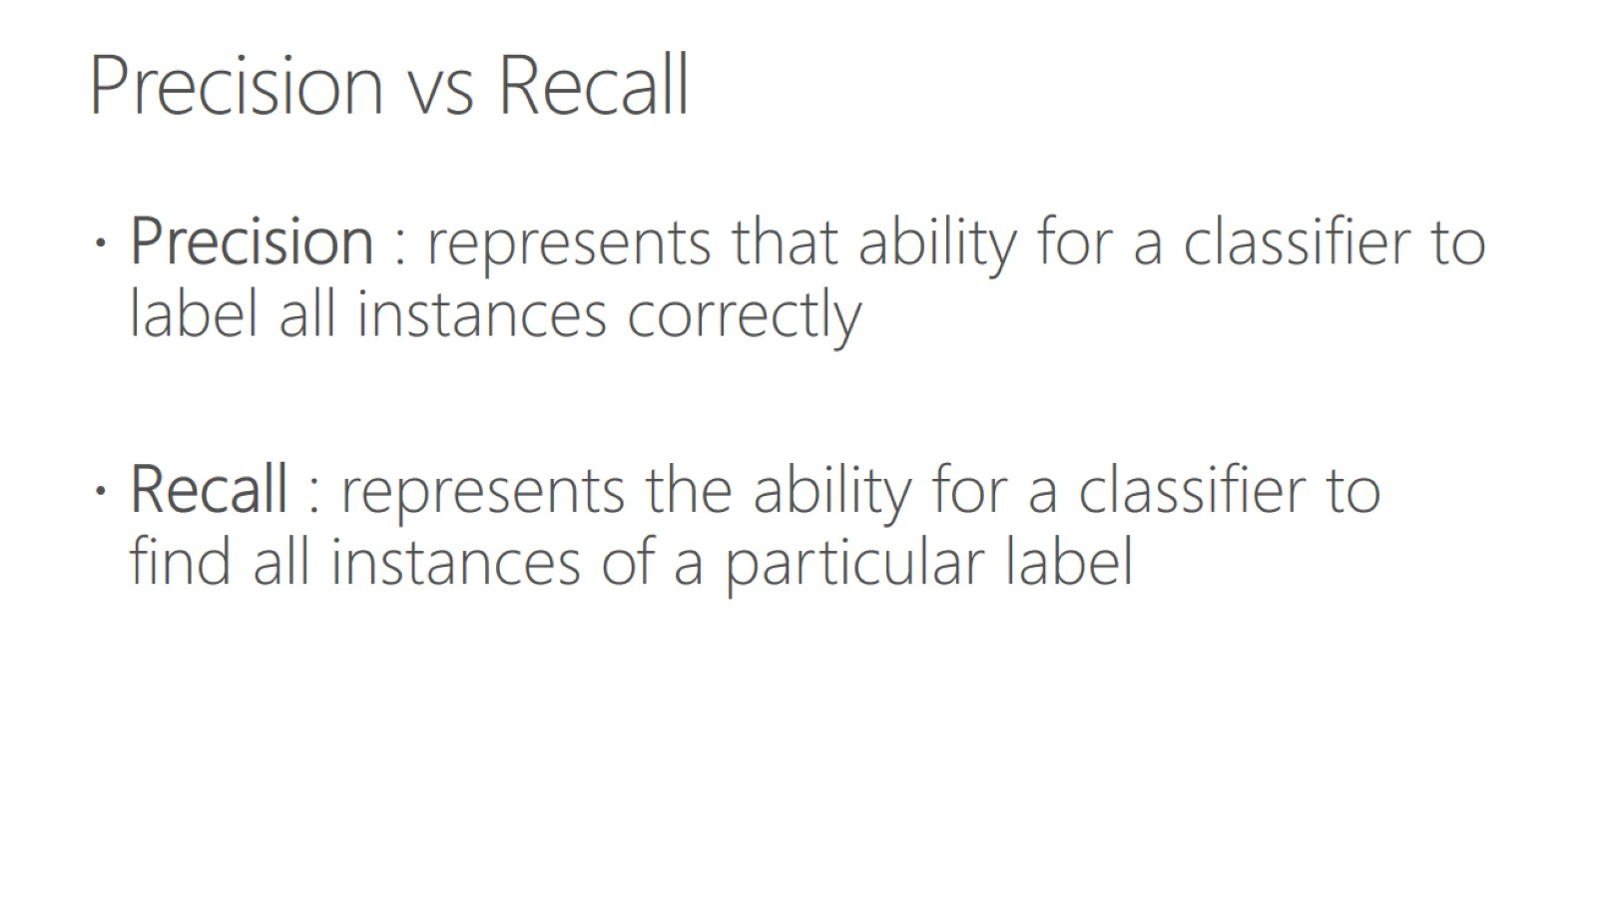
Precision vs Recall

Slide 30
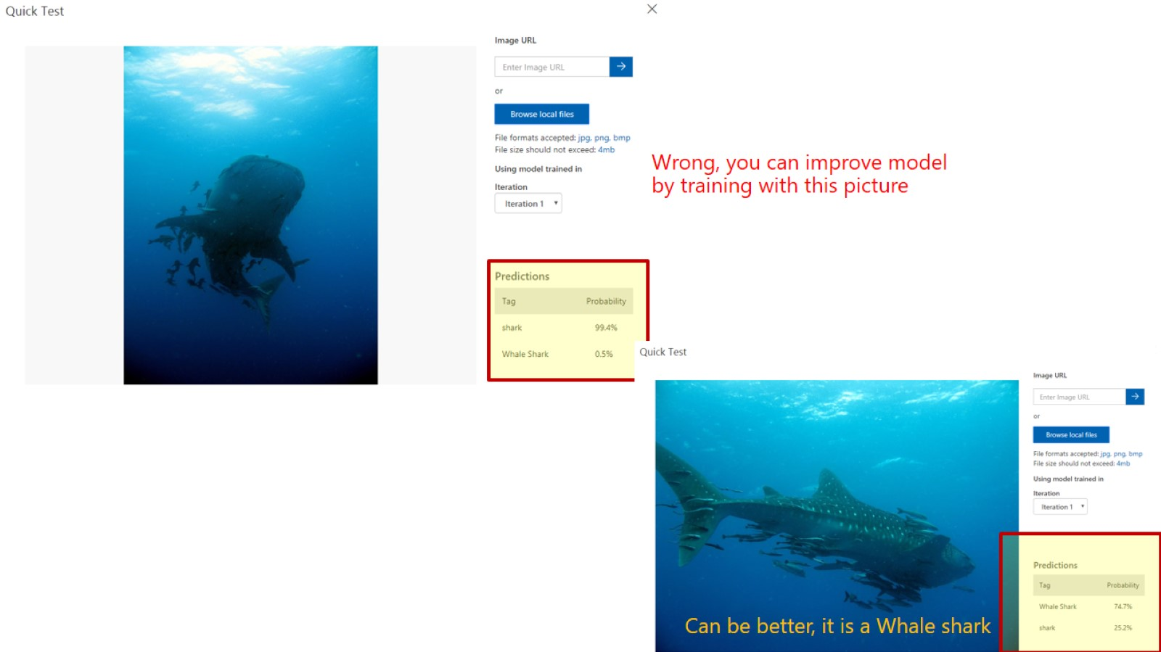

Slide 31
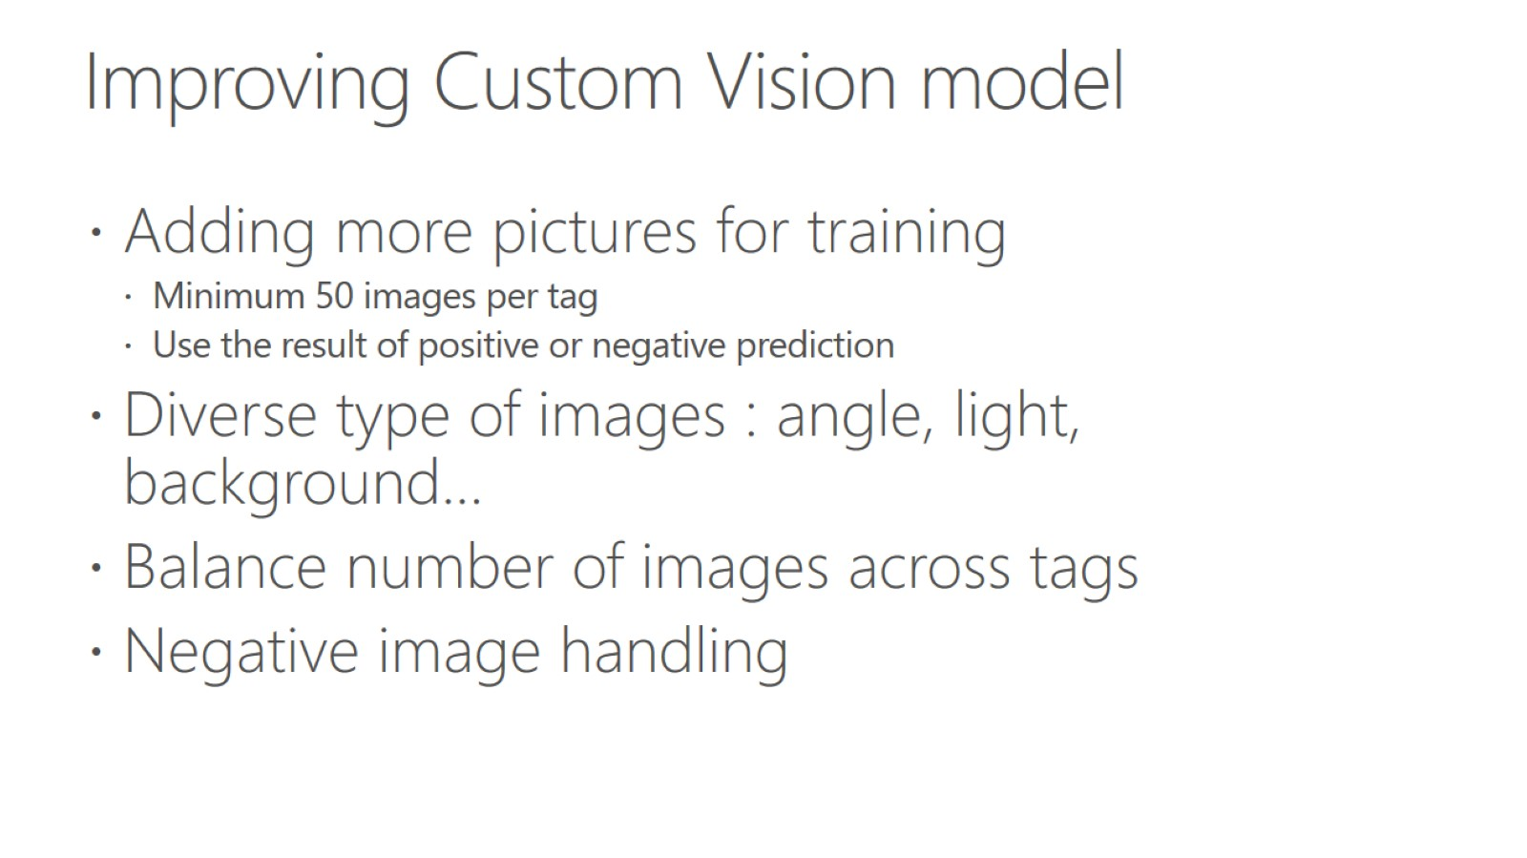
Improving Custom Vision model

Slide 32
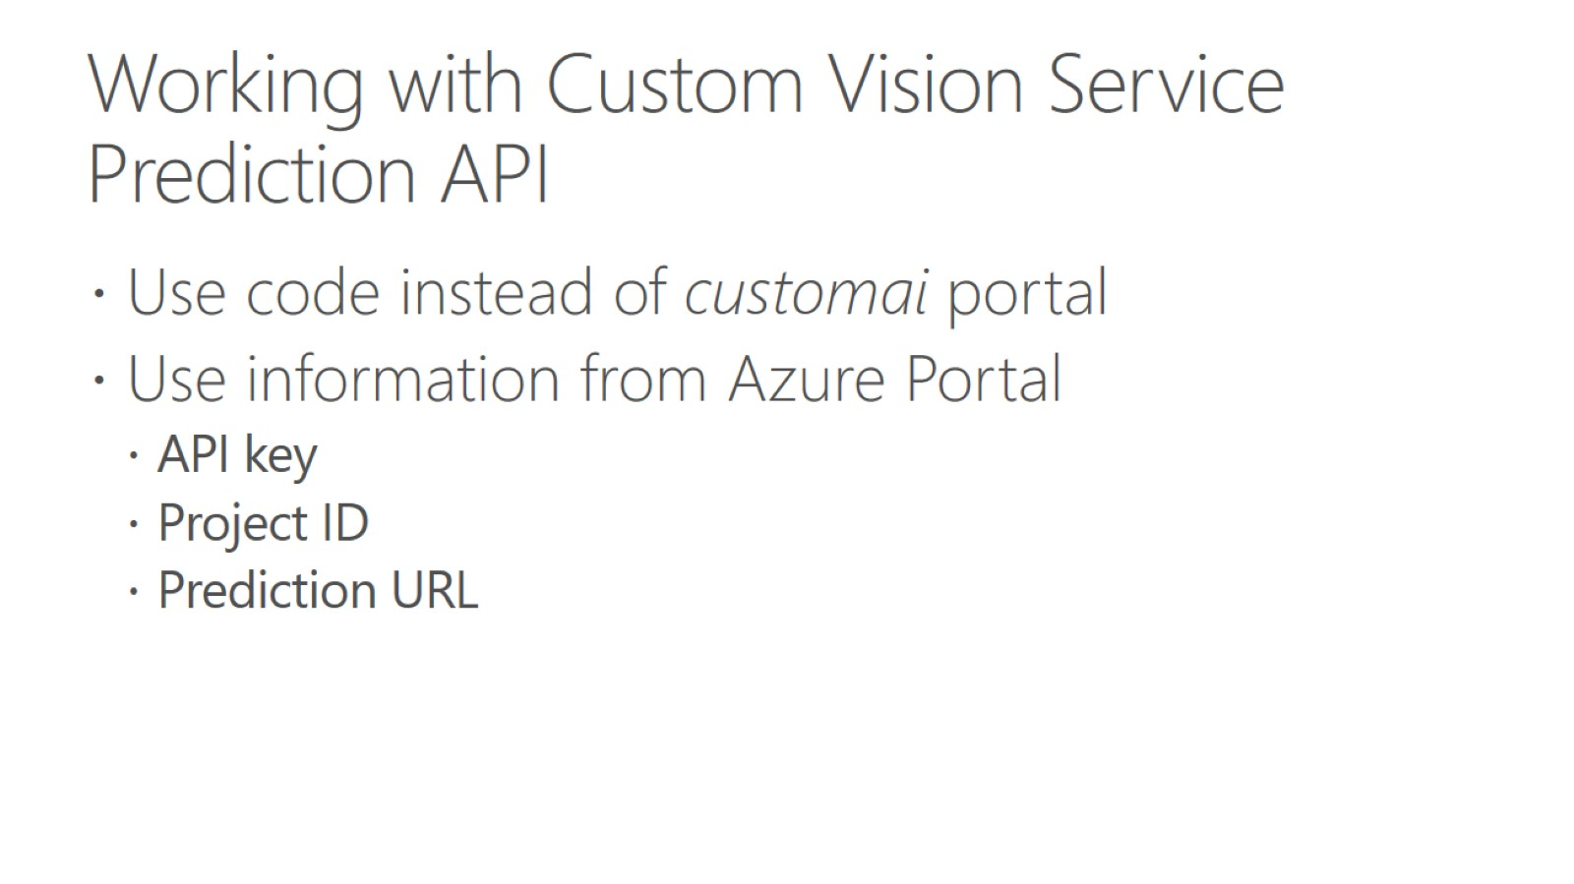
Working with Custom Vision Service Prediction API

Slide 33
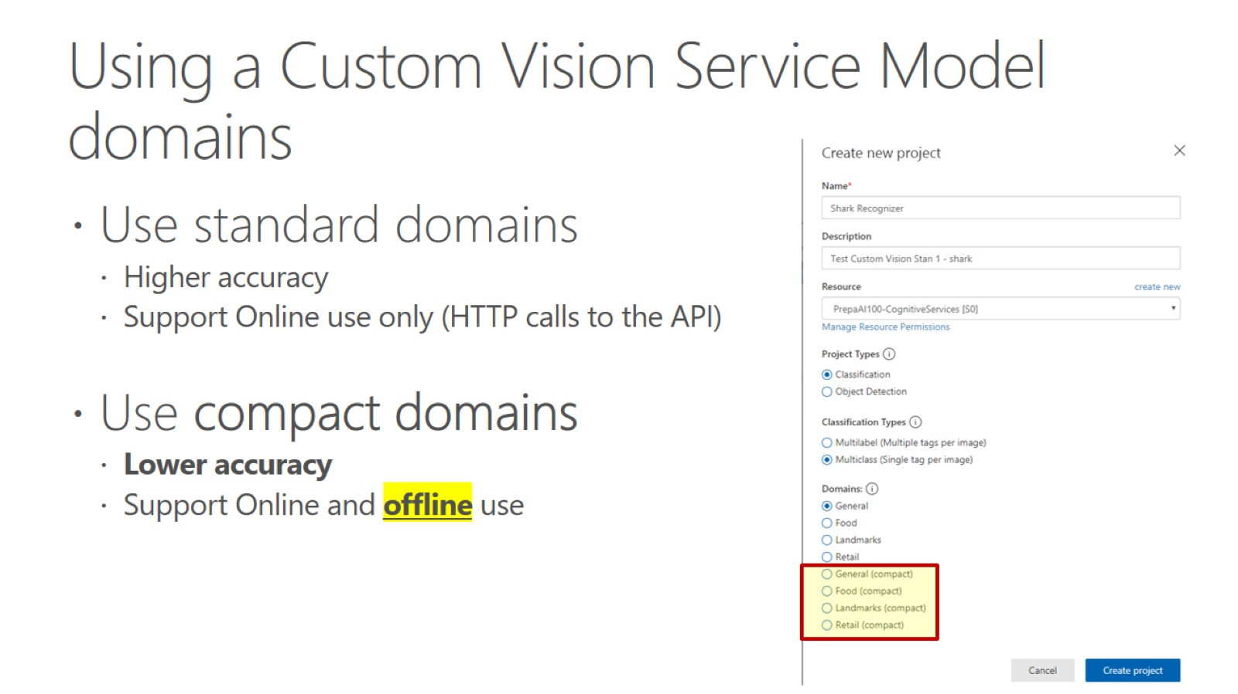
Using a Custom Vision Service Model domains

Slide 34
Hands on lab - Let’s try out the Vision Recognition
Step 1: Go to https://www.customvision.ai/

Slide 35
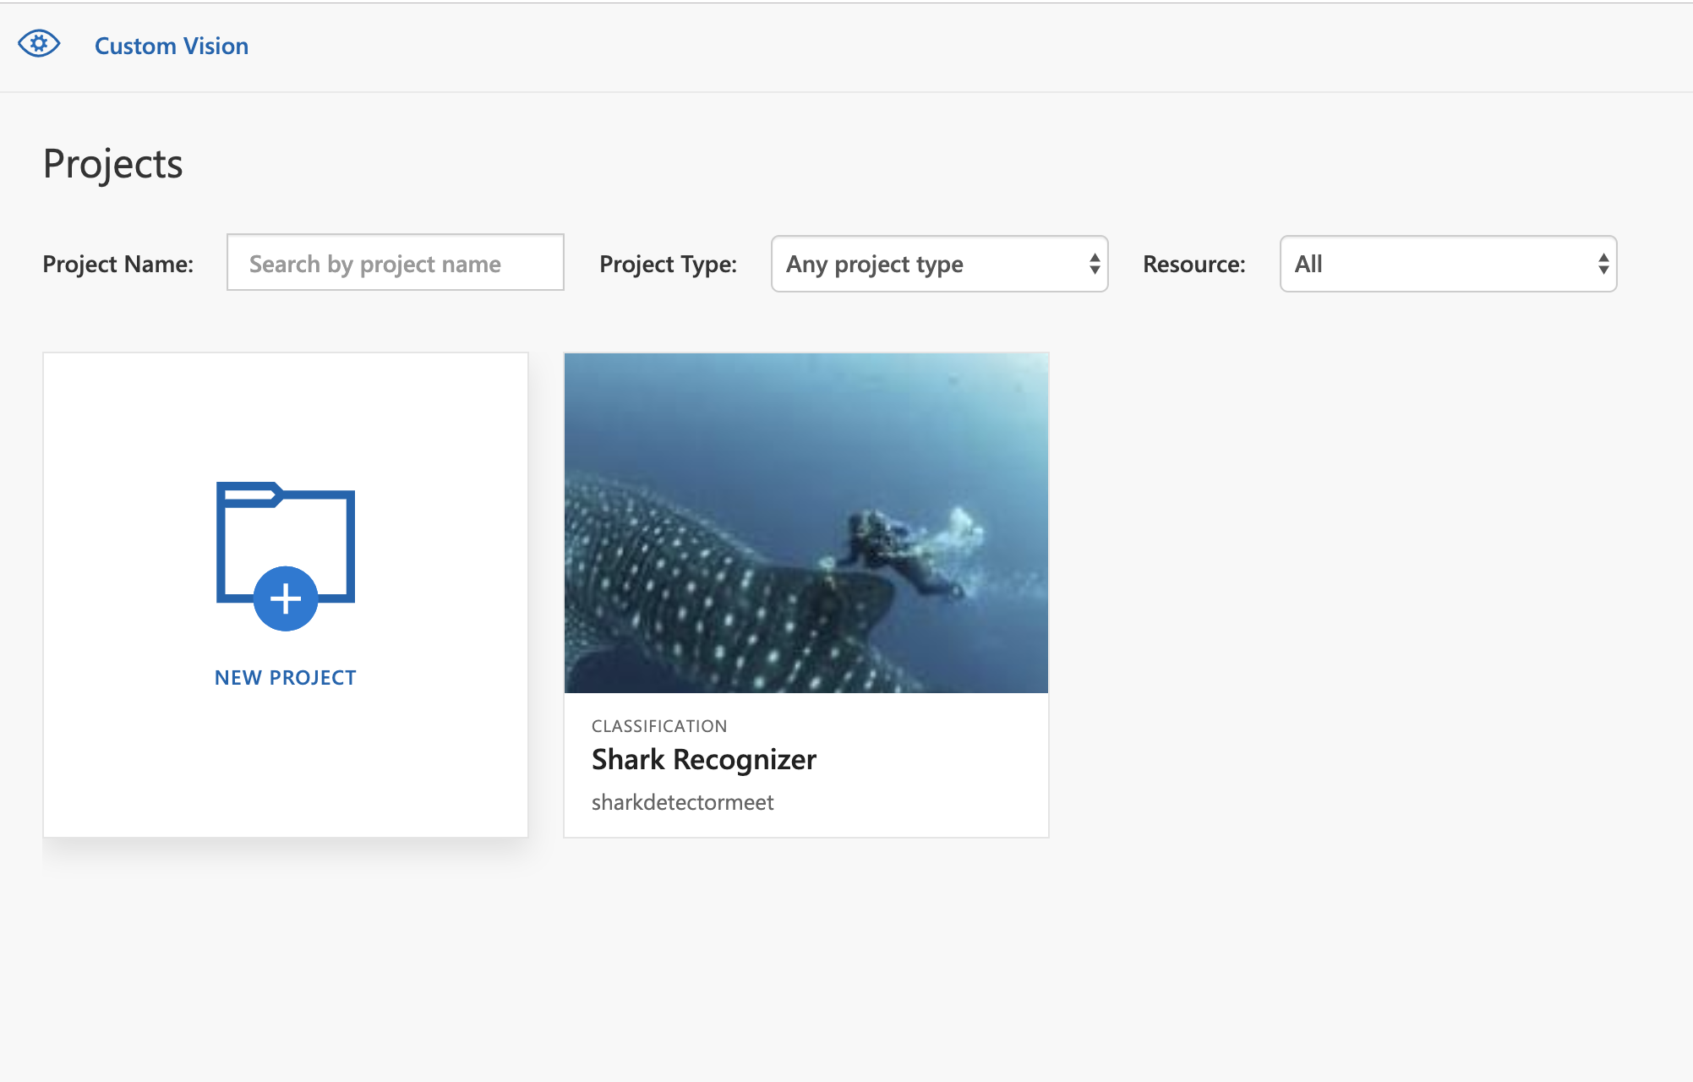
Hands on lab - Let’s try out the Vision Recognition
Step 2: Create new project!

Slide 36
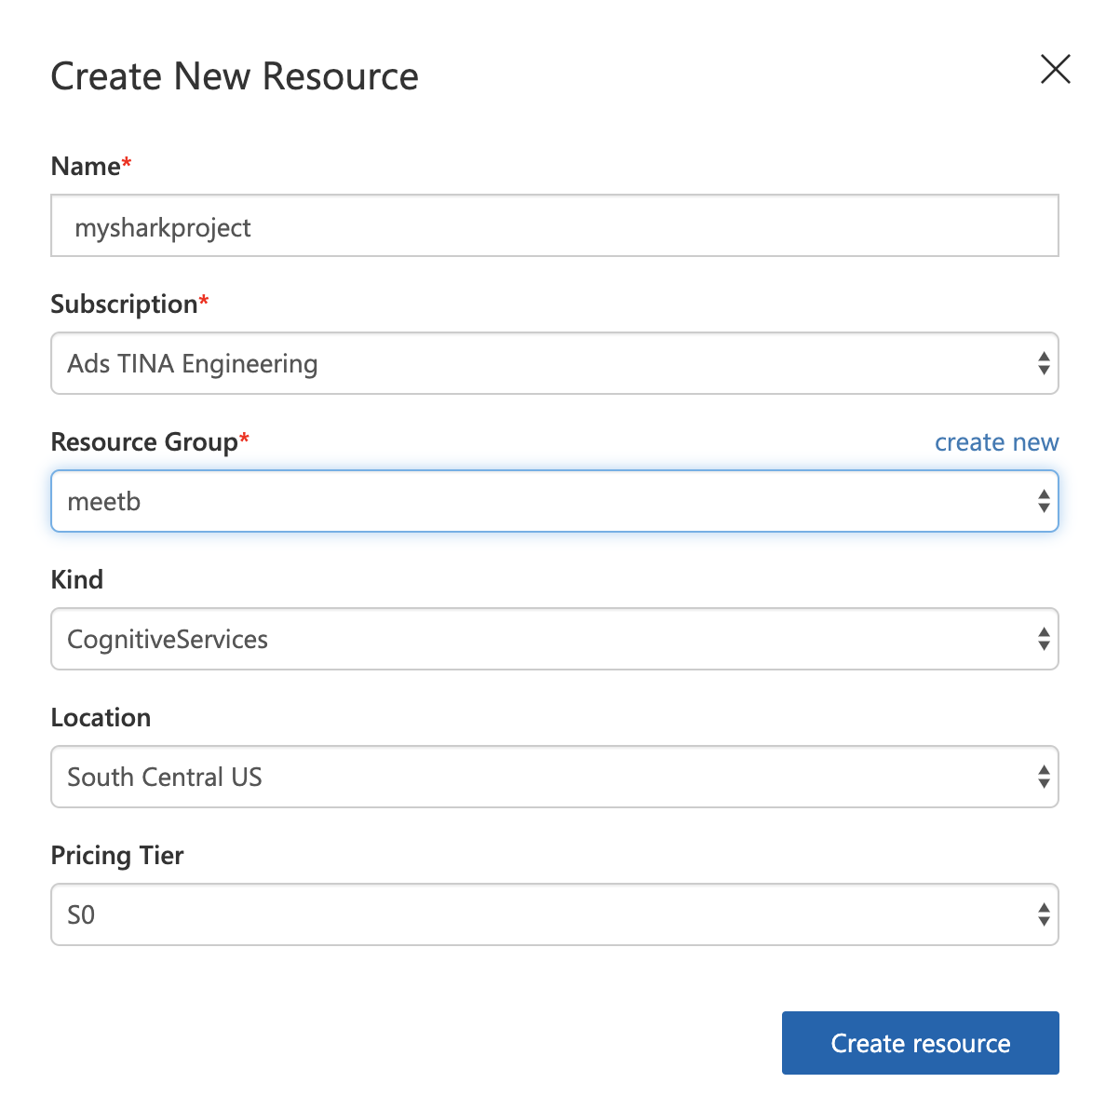
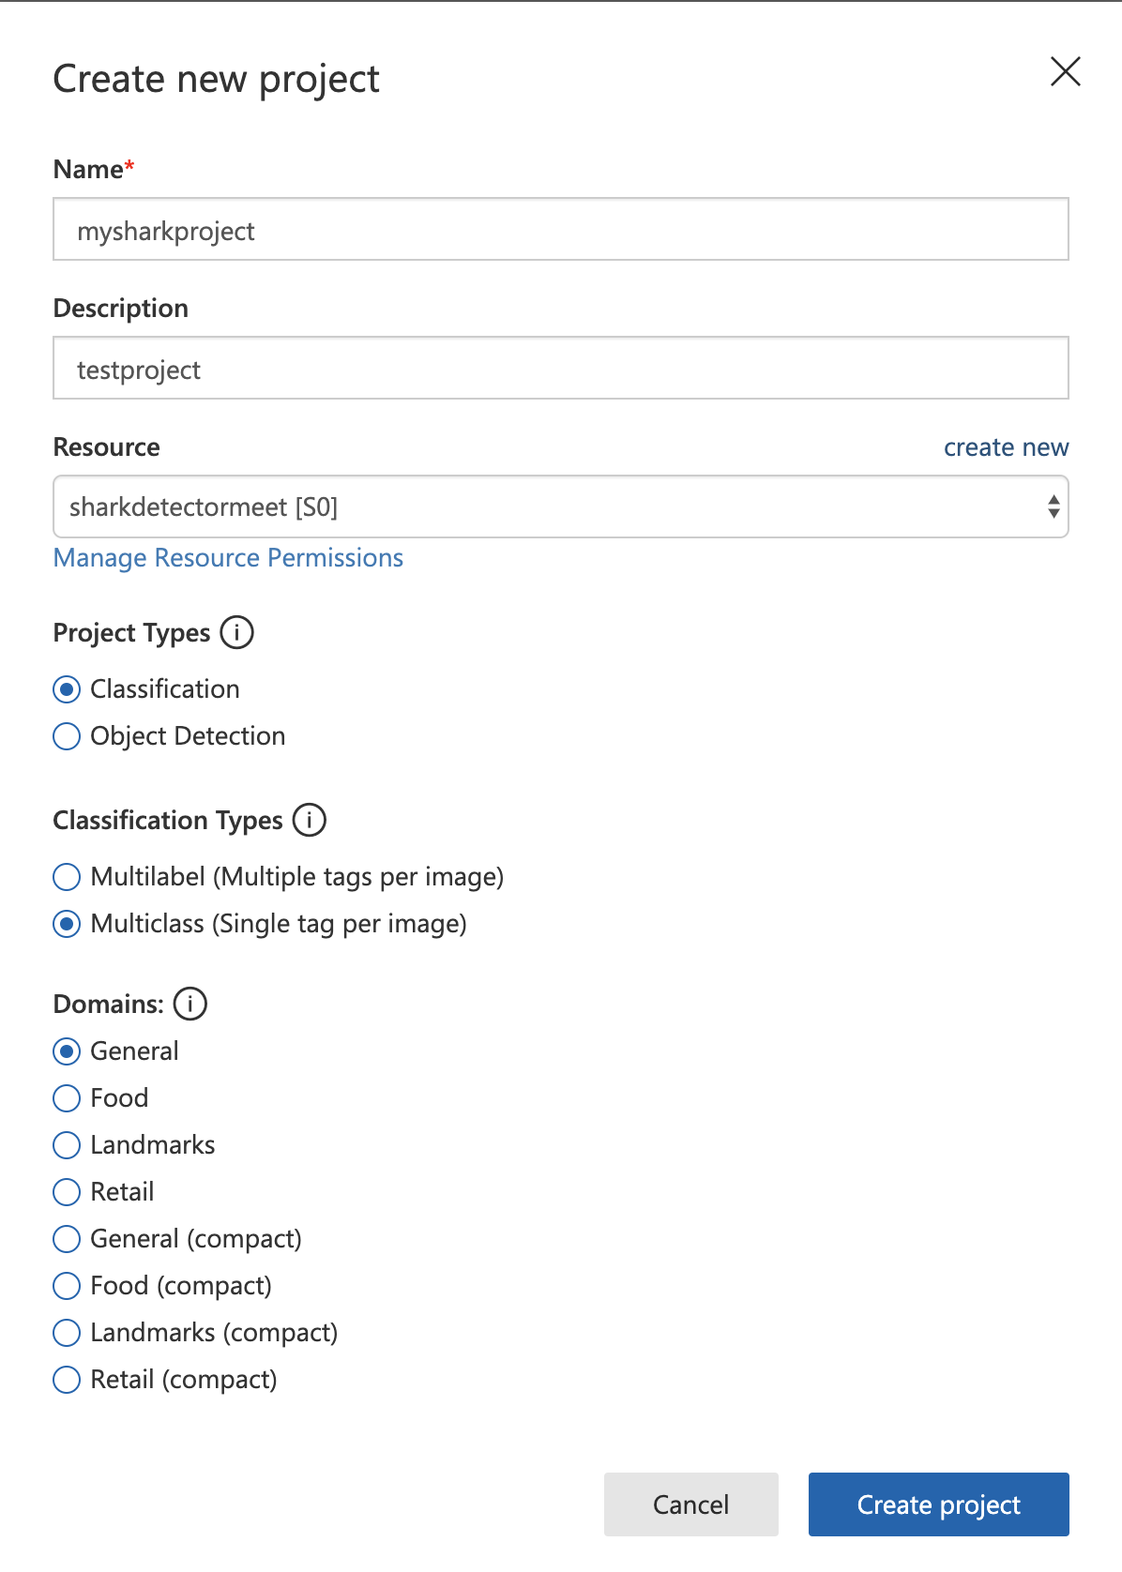
Hands on lab - Let’s try out the Vision Recognition
Step 3: Enter input for your project

Slide 37
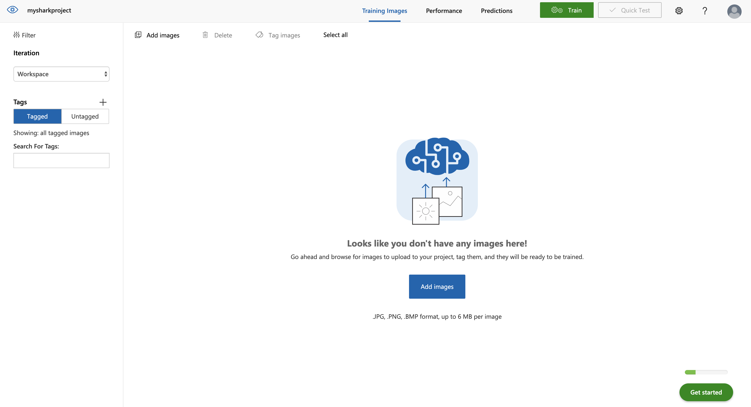
Hands on lab - Let’s try out the Vision Recognition
Step 4: Add images

Slide 38
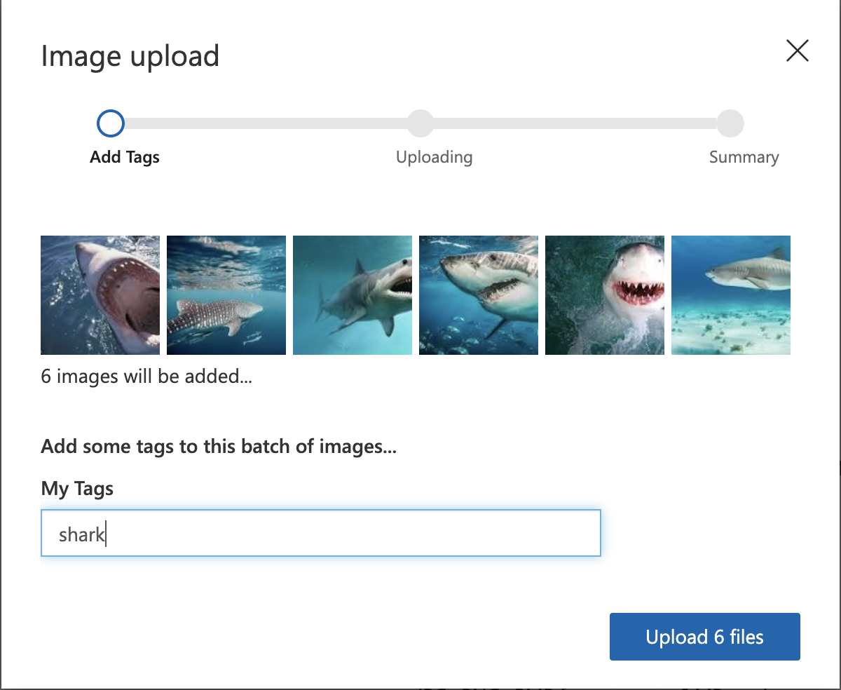
Hands on lab - Let’s try out the Vision Recognition
Step 5: Download images and upload them.
To download go to https://aka.ms/sharkvision and https://aka.ms/sharkvision.zip
Once you unzip, only upload the images from the sharkvision.zip folder

Slide 39
Hands on lab - Let’s try out the Vision Recognition
Step 5: Download images and upload them.
To download go to https://github.com/meet-bhagdev/ai-100/blob/master/sharks.zip and https://github.com/meet-bhagdev/ai-100/blob/master/whalesharks.zip
Once you unzip, only upload the images from the sharks.zip

Slide 40
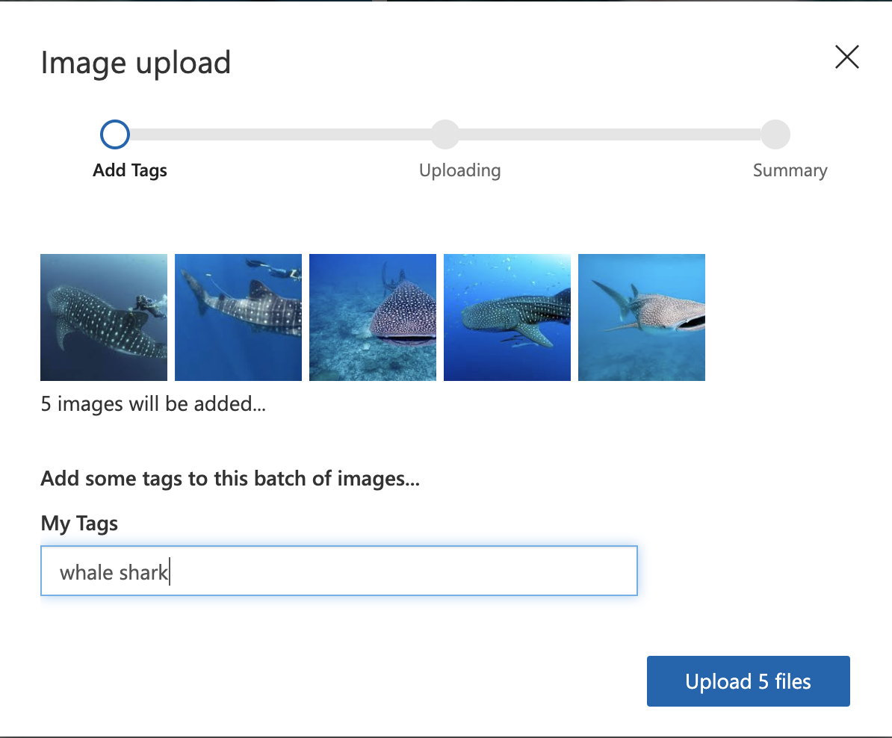
Hands on lab - Let’s try out the Vision Recognition
Step 6: Download images and upload them.
Now upload the images from the whale shark folder

Slide 41
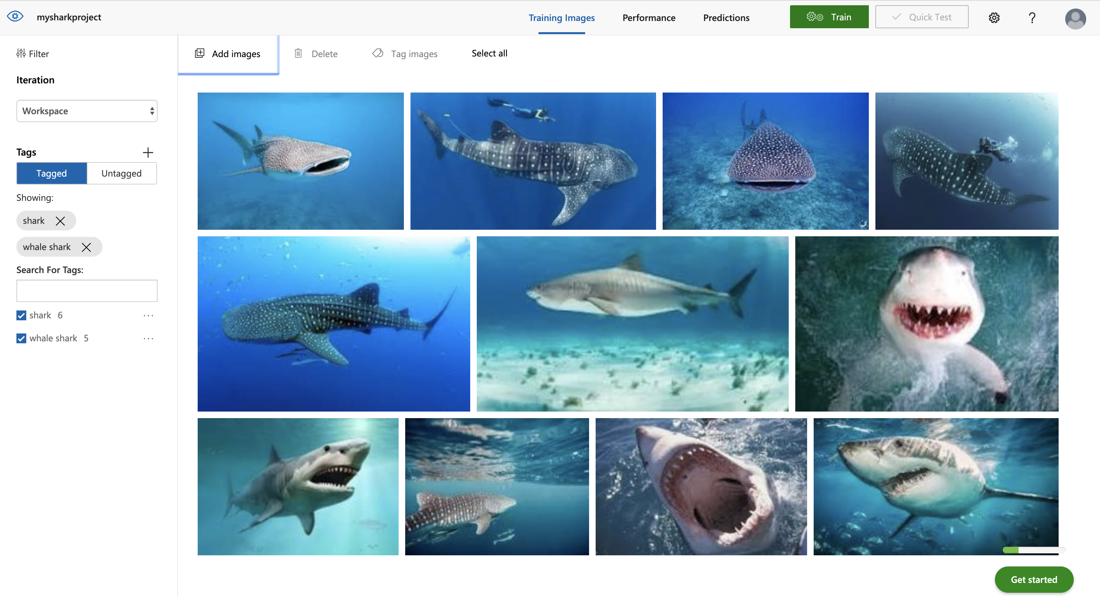
Hands on lab - Let’s try out the Vision Recognition
Step 6: Train the model

Slide 42
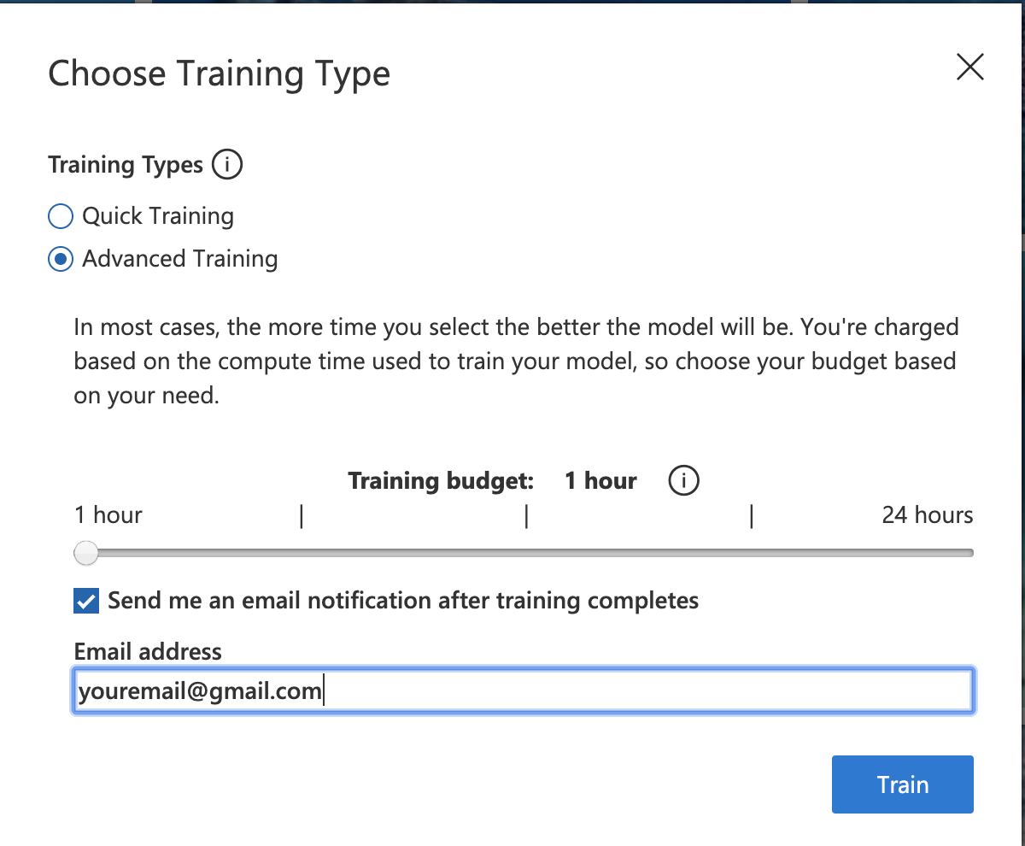
Hands on lab - Let’s try out the Vision Recognition
Step 7: Choose your training
For this workshop we will choose advance
training.
Don’t forget to enter your email

Slide 43
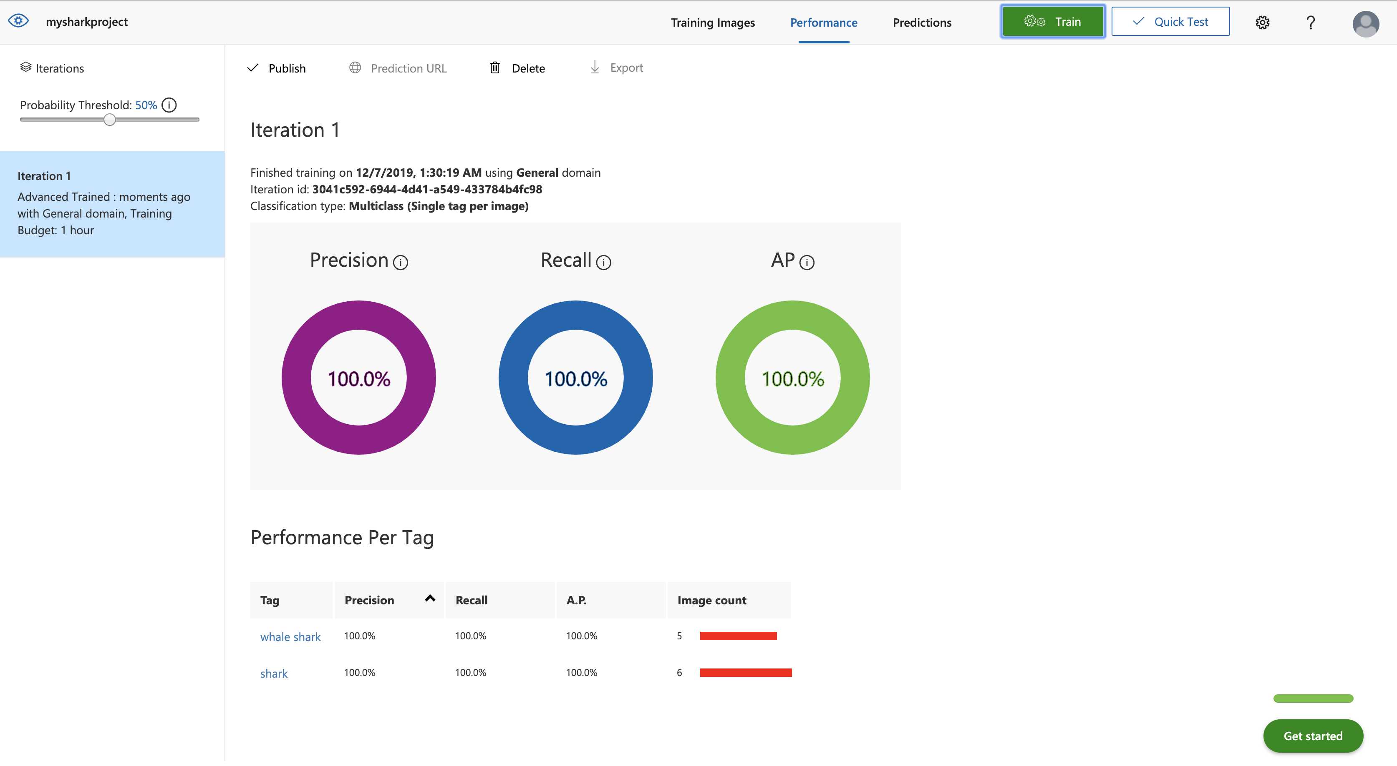
Hands on lab - Let’s try out the Vision Recognition
Step 8: Let’s test our model

Slide 44
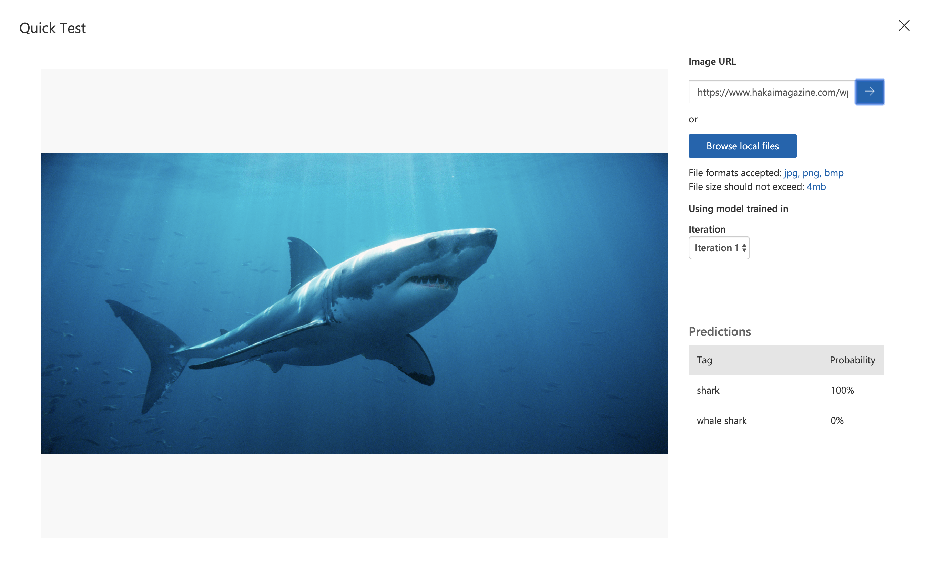
Hands on lab - Let’s try out the Vision Recognition
Step 9: Paste this url and test
Your model –
https://www.hakaimagazine.com/wp-content/uploads/header-shark-eddies.jpg

Slide 45
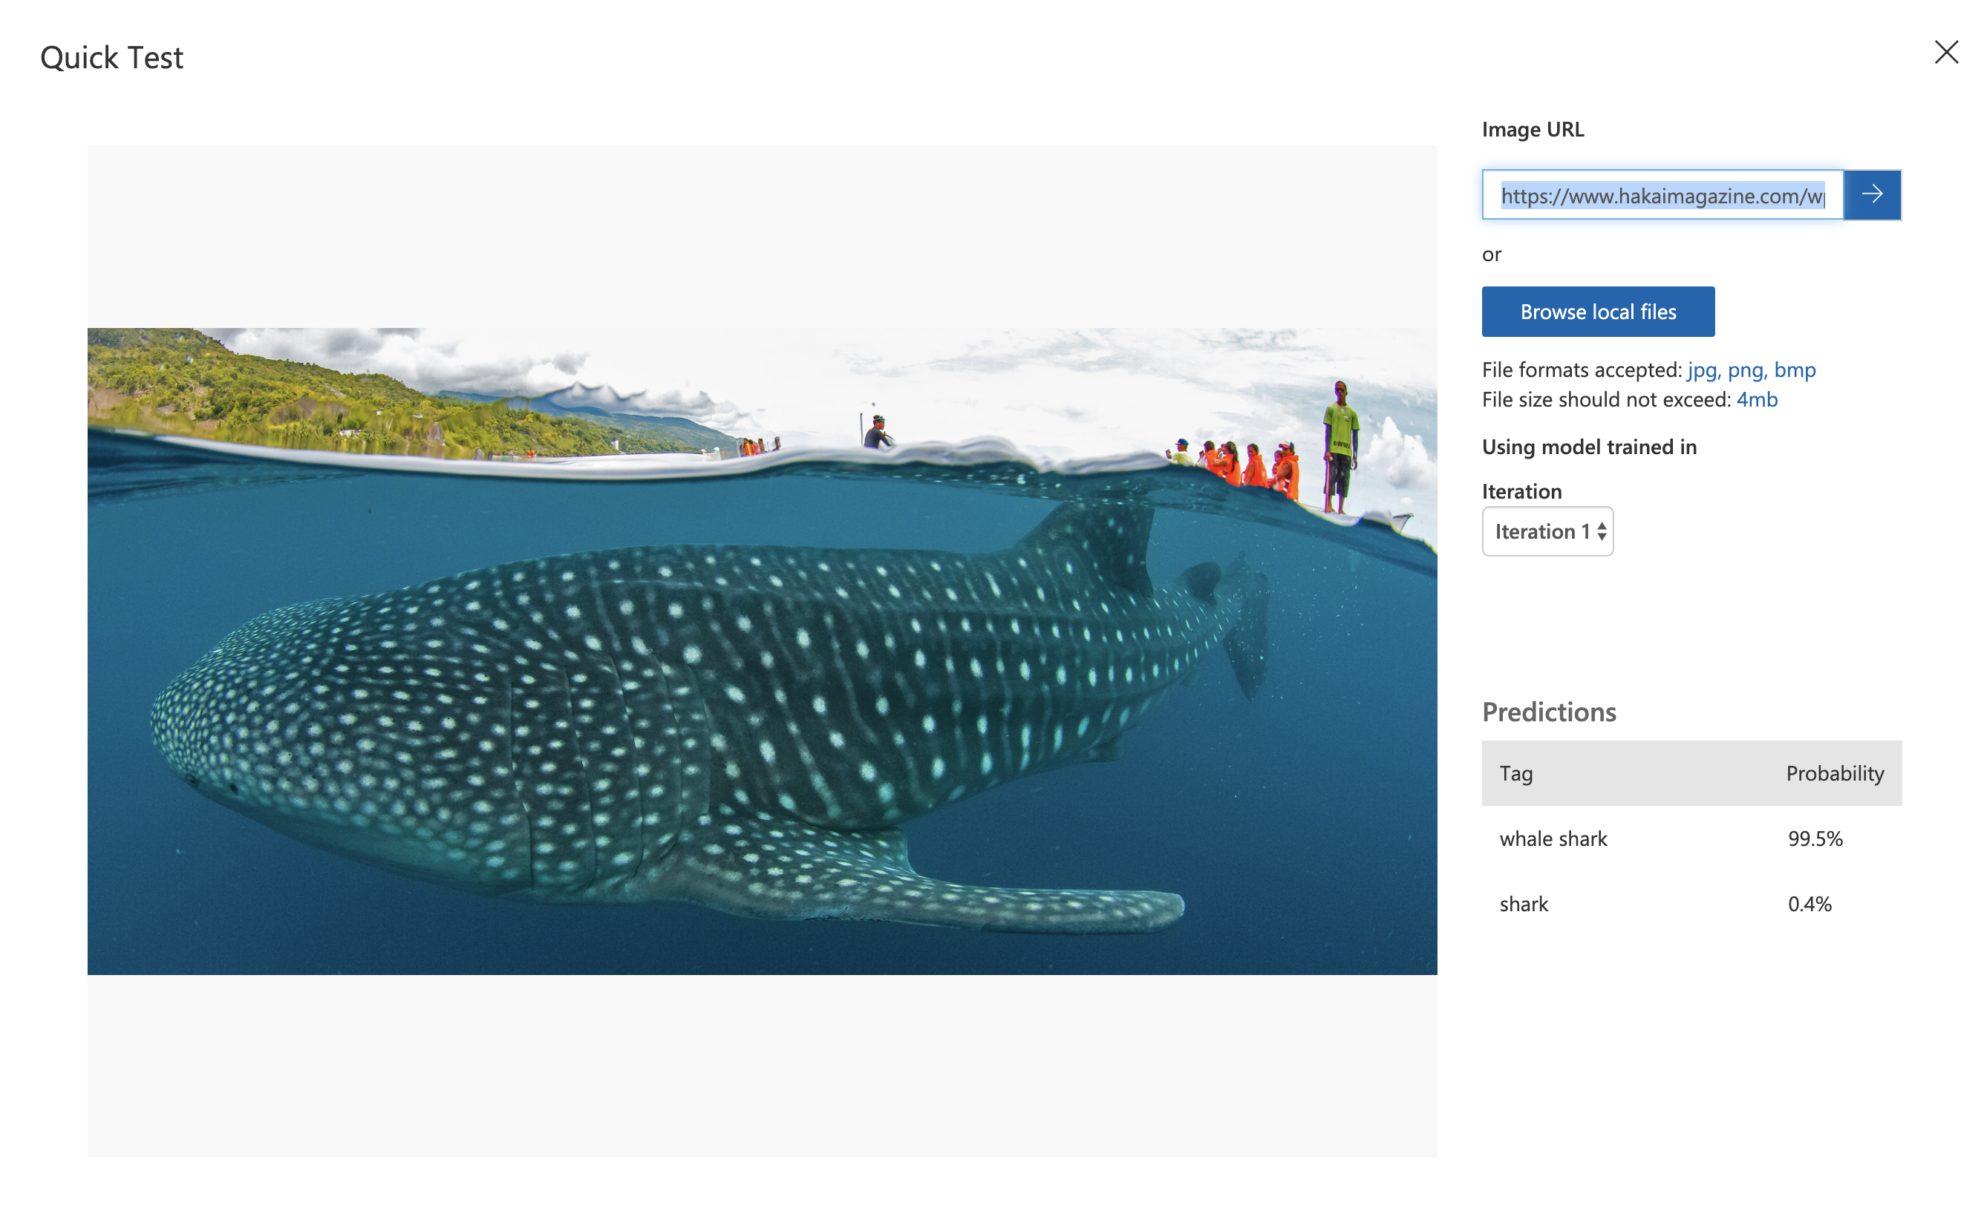
Hands on lab - Let’s try out the Vision Recognition
Step 9: Paste this url and test
Your model –
https://www.hakaimagazine.com/wp-content/uploads/header-tourist-shark-feeding.jpg

Slide 46
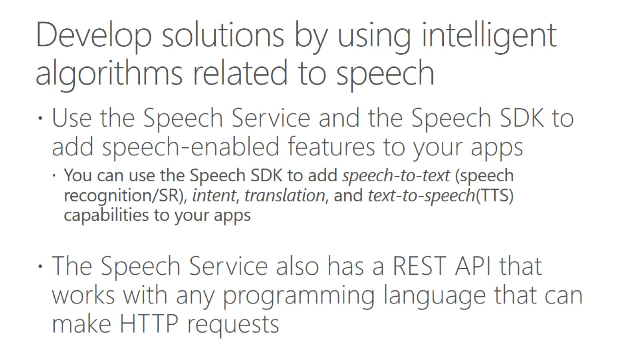
Develop solutions by using intelligent algorithms related to speech

Slide 47
Hands on lab - Identify faces and expressions by using the Computer Vision API in Azure Cognitive Services
Go to this link - https://docs.microsoft.com/en-us/learn/modules/identify-faces-with-computer-vision/1-introduction

Slide 48
Hands on lab - Process images with the Computer Vision service
Go to this link - https://docs.microsoft.com/en-us/learn/modules/create-computer-vision-service-to-classify-images/1-introduction

Slide 49
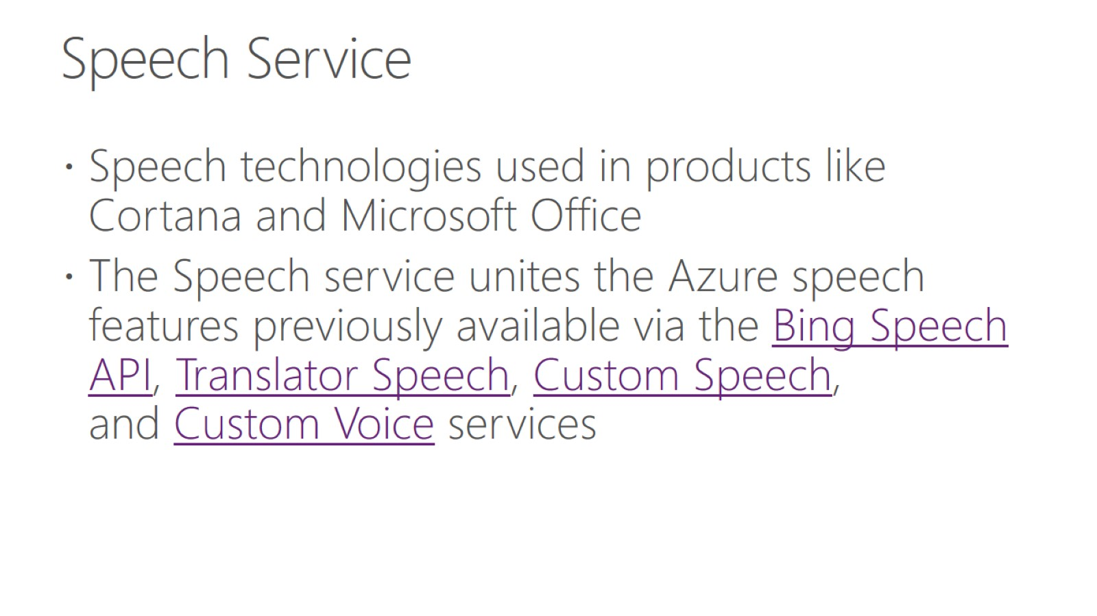
Speech Service

Slide 50
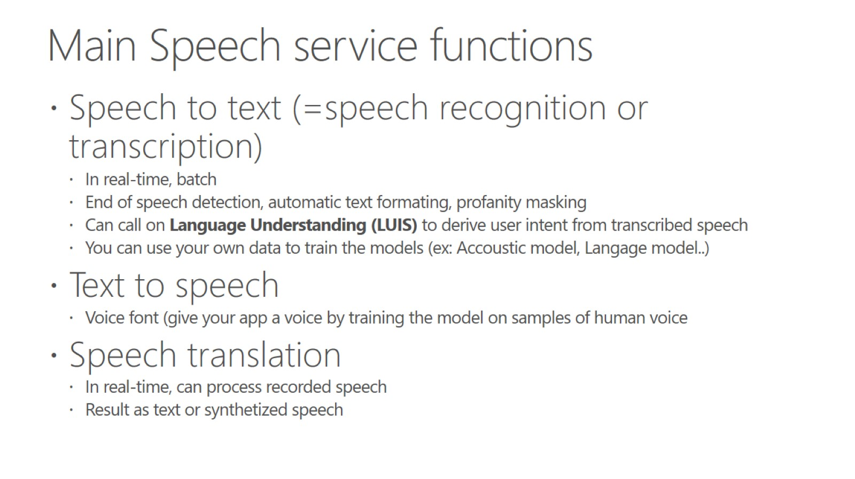
Main Speech service functions

Slide 51
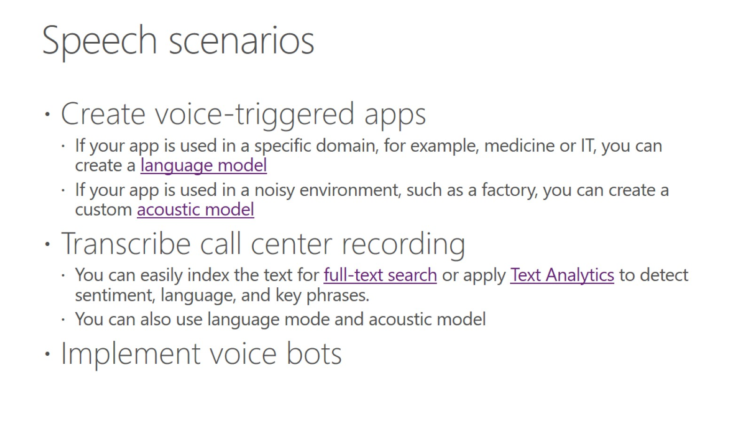
Speech scenarios

Slide 52
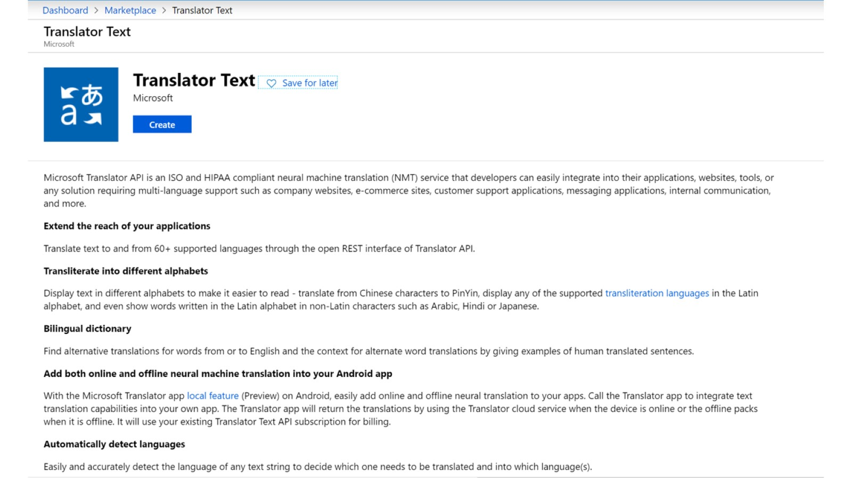

Slide 53
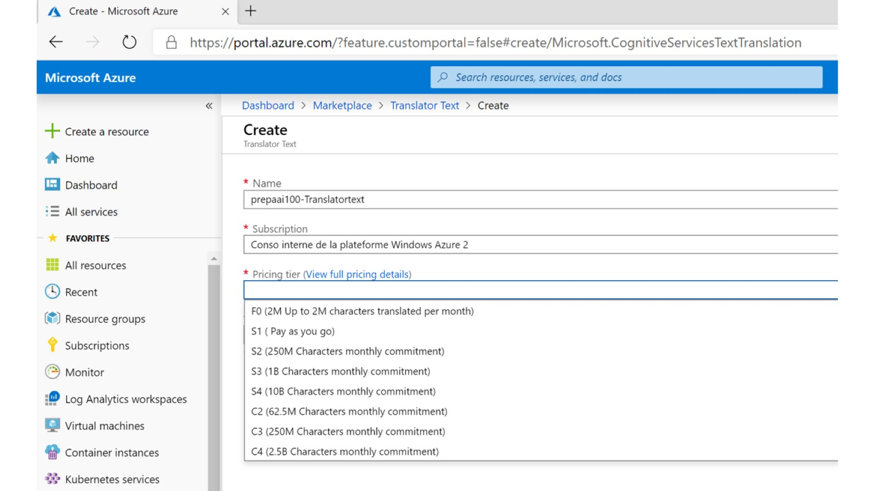

Slide 54
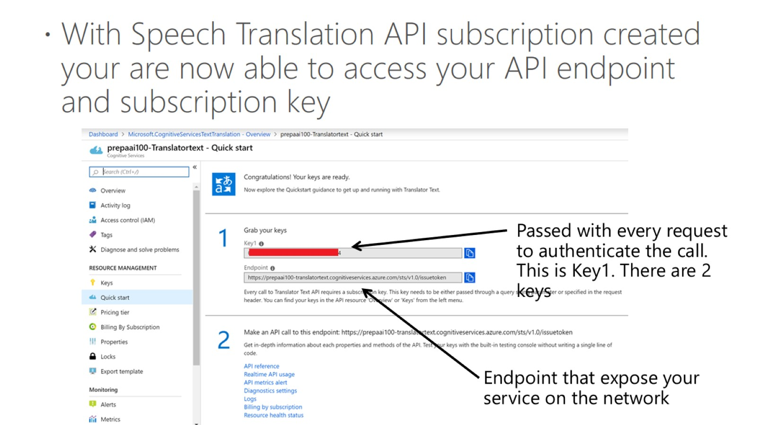

Slide 55
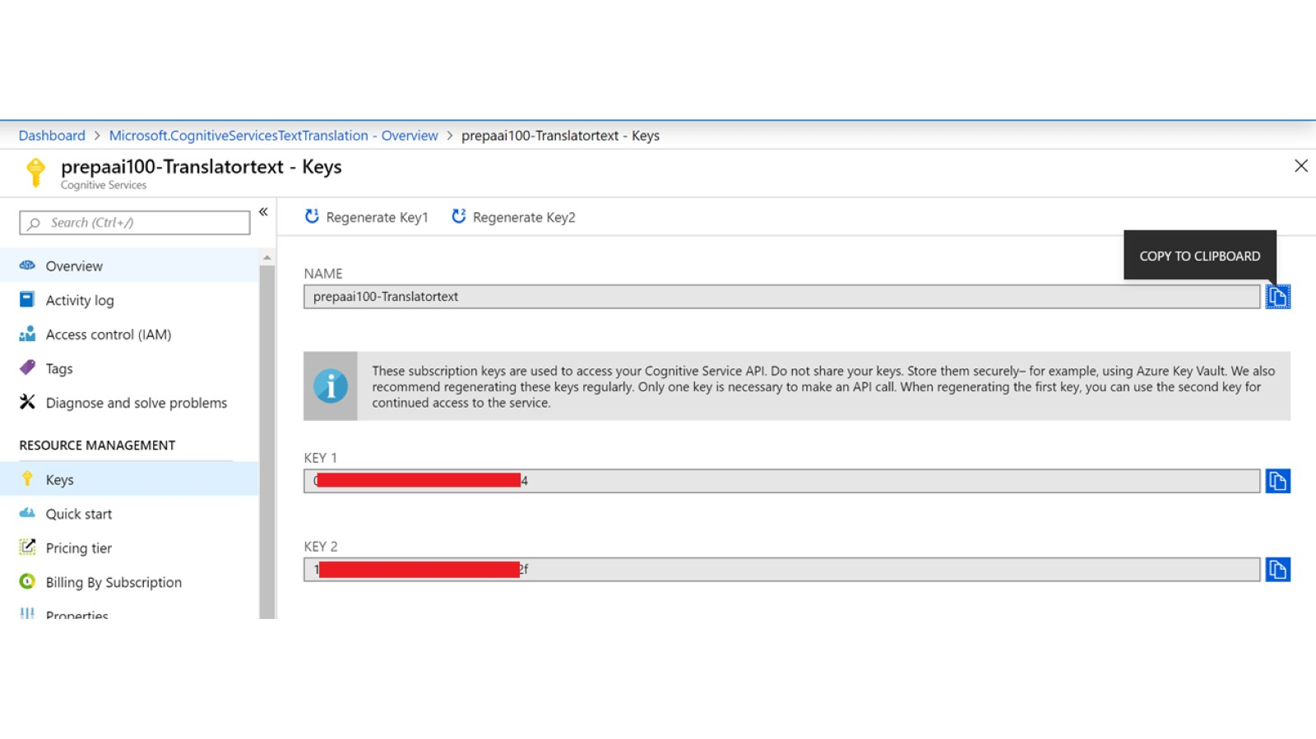

Slide 56

Develop solutions by using intelligent algorithms related natural language processing

Slide 57

Custom acoustic model

Slide 58

Custom language model

Slide 59

Language APIs

Slide 60

Test Text Analytics API

Slide 61

Bing Search

Slide 62

Bing Search

Slide 63
Hands on lab - Classify and moderate text with Azure Content Moderator
Go to this link - https://docs.microsoft.com/en-us/learn/modules/classify-and-moderate-text-with-azure-content-moderator/1-introduction

Slide 64

Bing Search

Slide 65

Bing Search

Slide 66

Recommendations and decision making Custom Decision Service

Slide 67

Custom Decision Service

Slide 68

Custom Decision Service

Slide 69


Slide 70

Azure Bot Service

Slide 71

Enable robust GDPR compliance

Slide 72


Slide 73

AI reference Architecture

Slide 74

When you need Custom AI ?

Slide 75

Machine Learning at scale

Slide 76

Machine Learning at scale

Slide 77

Machine Learning at scale

Slide 78

Challenges with Machine learning at scale

Slide 79

Choosing a natural language processing technology in Azure

Slide 80

Azure HDInsight vs Cognitive Services

Slide 81

Azure Databricks

Slide 82

Azure Databricks

Slide 83

Apache Spark-based analytics platform

Slide 84

Azure Databricks

Slide 85


Slide 86

Example : Databrick + cognitives services

Slide 87

Training of Python scikit-learn and deep learning models on Azure

Slide 88

Batch scoring of Python machine learning models on Azure

Slide 89

Distributed training of deep learning models on Azure

Slide 90

Build a real-time recommendation API on Azure

Slide 91

Azure IoT Reference Architecture

Slide 92

Process IoT telemetry data

Slide 93

What is Edge computing ?

Slide 94

Edge Tiers

Slide 95

Azure IoT Edge

Slide 96

Example of IoT Edge solution

Slide 97

Example of IoT Edge solution

Slide 98

Azure Edge in action

Slide 99


Slide 100


Slide 101


Slide 102


Slide 103


Slide 104


Slide 105


Slide 106


Slide 107


Slide 108

EdgeAgent, EdgeHub

Slide 109

Microsoft IoT Edge modules

Slide 110


Slide 111

Azure Stream Analytics

Slide 112


Slide 113


Slide 114


Slide 115


Slide 116

Main edge Scenarios for Azure Stream Analytics

Slide 117


Slide 118


Slide 119

Performing sentiment analysis by using Azure Stream Analytics and Azure Machine Learning Studio

Slide 120

Stream analytics with Spark or Storm

Slide 121

Identify storage required to store logging, bot state data, and Cognitive Services output

Slide 122
Choose the right data store
Relational database management options
Azure SQL DB
Azure Database for PostgreSQL
Azure Database for MySQL
Azure Database for MariaDB
SQL Server Big Data Clusters
Key Value Stores
CosmosDB
Azure cache for Redis
Document database
CosmosDB

Slide 123
Choose the right data store
Graph database
CosmosDB
Column family databases
CosmosDB
Azure cache for Redis
Data analytics
SQL Data Warehouse (now called Synapse Analytics)
SQL Server Big Data Clusters
Azure Data Lake
Azure Data Explorer
Search engine databases
Azure Search

Slide 124

Choose the right data store

Slide 125

Azure SQL Data Warehouse

Slide 126


Slide 127

Azure Data Lake Store

Slide 128

Azure Data Lake Analytics

